Slide 1
Improving Modern Techniques of Causal Inference: Finite Sample Performance of ATM and ATO Doubly Robust Estimators, Variance Estimation for ATO Estimators, and Contextualized Tipping Point Sensitivity Analyses for Unmeasured Confounding
Lucy D’Agostino McGowan

Slide 2
Thank you!
Notes:
Committee, Robert, Frank, Cindy, and Peter
Cohort: Alice and Alice, Svetlana, Jonathan, and Ryan
Jacquelyn, Alli, Mark
Family

Slide 3
Exploring finite-sample bias in propensity score weighting choices

Slide 4

Observational Studies
exposure
outcome

Slide 5
Observational Studies
Randomized Controlled Trials
Treatment
P=0.5
Control
P=0.5

Slide 6
Observational Studies
Treatment
P=0.9
Control
P=0.1

Slide 7
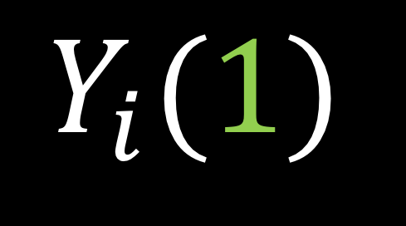

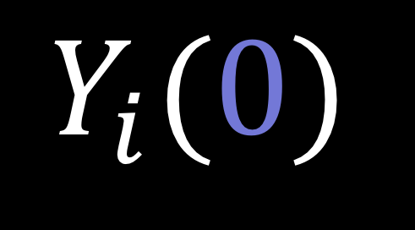
Potential outcomes
$$Y_{i}(0)$$
$$Y_{i}(1)$$
$$−$$
Notes:
In a study such as this, there are two potential outcomes for an individual I, Y i 0, _click_ the outcome if they are assigned the control and Y i 1, _click_ the outcome if they are assigned the treatment. Often our estimate of interest is the _click_ difference between these two outcomes. In reality, however only one of these two quantities is observable.

Slide 8
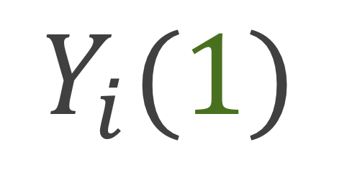
Potential outcomes
$$Y_{i}(0)$$
$$Y_{i}(1)$$
Notes:
If you are assigned the control, we can observe you Y i (0)

Slide 9
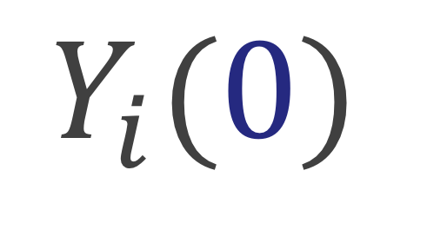
Potential outcomes
$$Y_{i}(0)$$
$$Y_{i}(1)$$
Notes:
And if you are assigned the treatment we can observe your Y i 1. This is often handled fundamentally as a missing data problem. While only one of these paired outcomes is observed, we can estimate what the other, the counterfactual, would have been had the participant received the opposite treatment.

Slide 10
Potential outcomes
$$Y_{i}(0)$$
$$Y_{i}(1)$$
$$−$$
Notes:
Ultimately, we are interested in some estimate of the treatment effect, for example we may want to know what the average treatment effect is across all participants, or we may want to know what the average treatment effect is among participants who received the treatment. I’m going to show you a few of these causal estimands and how we can estimate them using specific weights

Slide 11
Causal Quantities

Slide 12

Average treatment effect
$$E[Y\left(1\right)−Y\left(0\right)]$$

Slide 13

Average treatment effect
$$\frac{1}{n}\sum_{i=1}^{n}{Y_{i}Z_{i}}−\frac{1}{n}\sum_{i=1}^{n}{Y_{i}(1−Z_{i})}$$
Notes:
In a randomized setting, we can just take the the difference between the mean outcome among the treated and the mean outcome among the controls

Slide 14

No unmeasured confounders
$$\left(Y\left(0\right),Y\left(1\right)\right)⊥Z|X$$
Notes:
In the observational study setting, given that there are no unmeasured confounders, which is often written in this way, that the potential outcomes are independent of treatment assignment given X, we can use propensity scores to estimate the average treatment effect

Slide 15

Propensity score
$$e_{i}=P(Z_{i}=1|X)$$
Notes:
the probability that you received treatment given your observed pre-treatment covariates. A lot of times we fit this with a logistic regression

Slide 16

Average treatment effect
$$w_{ATE}=\frac{Z_{i}}{e_{i}}+\frac{{1 −Z}_{i}}{1 −e_{i}}$$

Slide 17
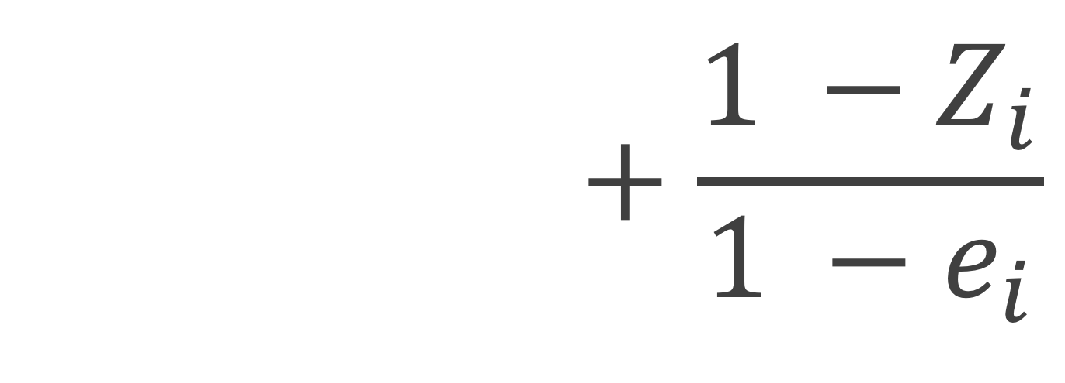
Average treatment effect
$$w_{ATE}=\frac{Z_{i}}{e_{i}}+\frac{{1 −Z}_{i}}{1 −e_{i}}$$

Slide 18

Average treatment effect
$$w_{ATE}=\frac{Z_{i}}{e_{i}}+\frac{{1 −Z}_{i}}{1 −e_{i}}$$

Slide 19

Average treatment effect
$$\frac{\sum_{i=1}^{n}{Y_{i}Z_{i}w_{i}}}{\sum_{i=1}^{n}{Z_{i}w_{i}}}−\frac{\sum_{i=1}^{n}{Y_{i}\left(1−Z_{i}\right)w_{i}}}{\sum_{i=1}^{n}{\left(1−Z_{i}\right)w_{i}}}$$
Notes:
In a randomized setting, we can just take the the difference between the mean outcome among the treated and the mean outcome among the controls

Slide 20
Notes:
The dark portion, the grey, are the propensity scores the top part of the mirrored histogram is the treated population and the bottom, the upside-down histogram is the control population. Then the green represents the weighted propensity scores for the treated and the blue is the weighted propensity scores for the controls.

Slide 21

Average treatment effect among the treated
$$E\left[Y\left(1\right)−Y\left(0\right)\right|Z=1]$$

Slide 22

Average treatment effect among the treated
$$w_{ATT}=\frac{e_{i}Z_{i}}{e_{i}}+\frac{e_{i}\left(1−Z_{i}\right)}{1 −e_{i}}$$

Slide 24

Average treatment effect among the controls
$$E\left[Y\left(1\right)−Y\left(0\right)\right|Z=0]$$

Slide 25

Average treatment effect among the controls
$$w_{ATC}=\frac{\left(1−e_{i}\right)Z_{i}}{e_{i}}+\frac{\left(1−e_{i}\right)\left(1−Z_{i}\right)}{1−e_{i}}$$

Slide 27

Average treatment effect among the evenly matchable
$$E\left[Y\left(1\right)−Y\left(0\right)\right|M_{d}=1]$$
Notes:
Here, the ATM depends on some distance measure d to determine whether each participant is deemed “evenly matchable”, Md=1. The less prevalent exposure in any region of the covariate space, as defined by d, is matchable in the sense that they would readily find mates in a 1:1 within-caliper matching without replacement.
This estimand was defined by Laurie in her dissertation a last year.
?? In contrast, the more prevalent exposure(s) could not all find mates in this matching scheme. ??

Slide 28

Average treatment effect among the evenly matchable
$$w_{ATM}=\frac{min\left\{e_{i}, 1−e_{i}\right\}}{{e_{i}Z}_{i}+(1 −e_{i})(1−Z_{i})}$$
Minimum of ATT and ATC weights (Samuels 2017)

Slide 30

Average treatment effect among the overlap population
$$w_{ATO}=\left(1−e_{i}\right)Z_{i}+ e_{i}(1−Z_{i})$$

Slide 32
ATE
ATT
ATC
ATM
AT0

Slide 33
ATE
ATT
ATC
ATM
AT0

Slide 34
ATE
ATT
ATC
ATM
AT0

Slide 35
Freedman & Berk Simulation

Slide 36
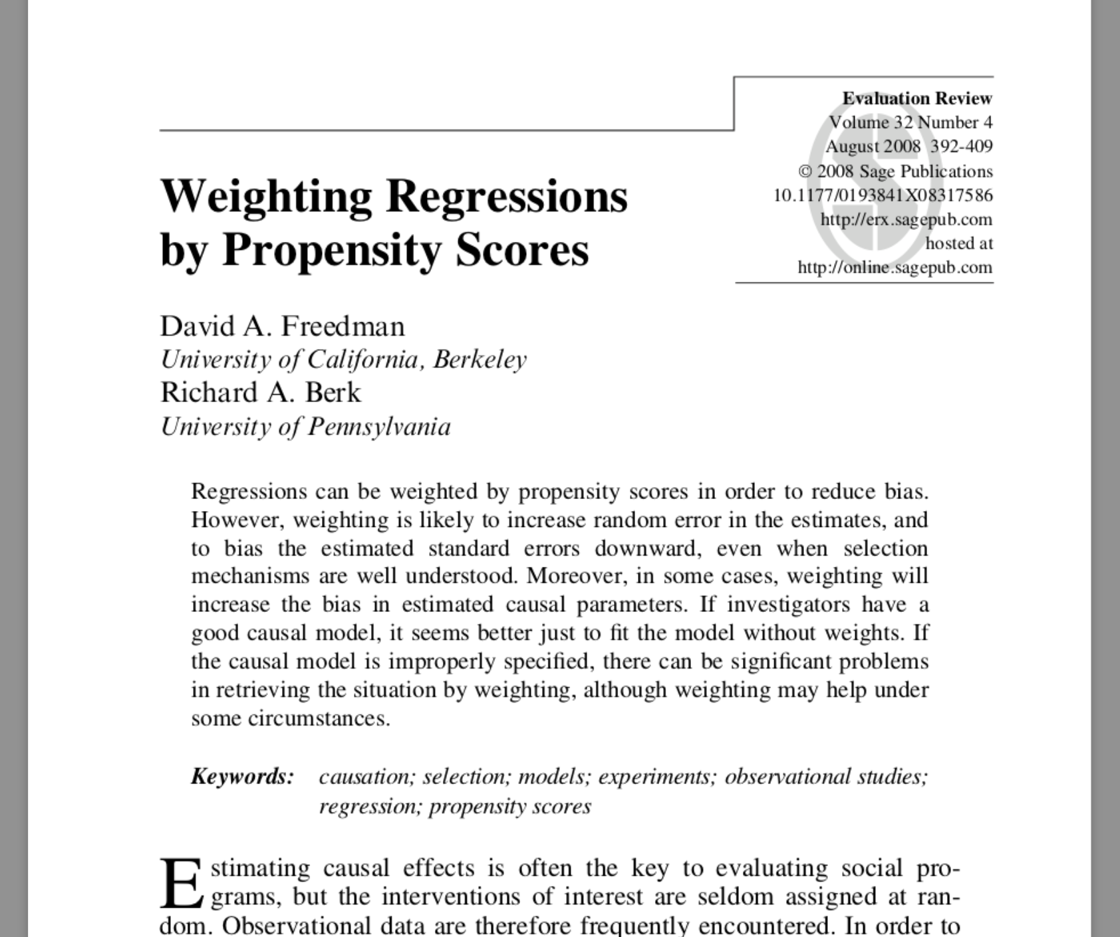

Slide 37
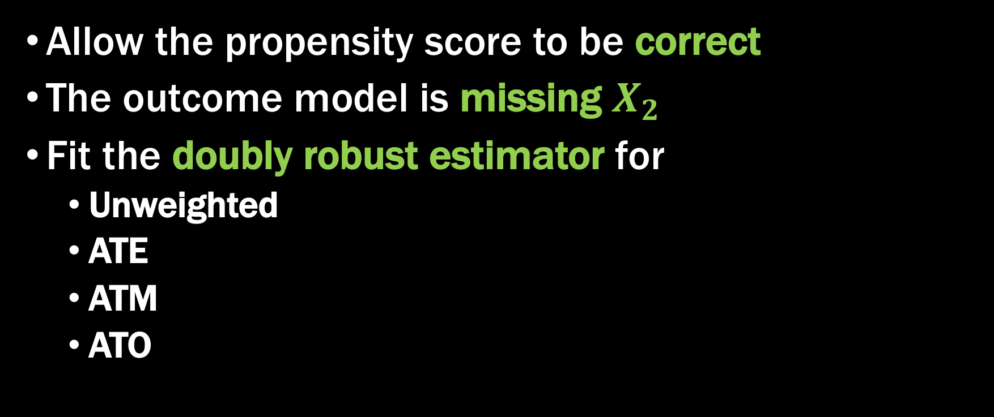
Fit a misspecified model
Allow the propensity score to be correct
The outcome model is missing $X_{2}$
Fit the doubly robust estimator for
Unweighted
ATE
ATM
ATO

Slide 38
Doubly Robust Estimator
Can misspecify either the propensity score model or the outcome model
Lunceford and Davidian (2004) proved an unbiased estimator for the ATE
Li and Greene proved an unbiased estimator for the ATM
We proved an unbiased estimator for the ATO

Slide 39
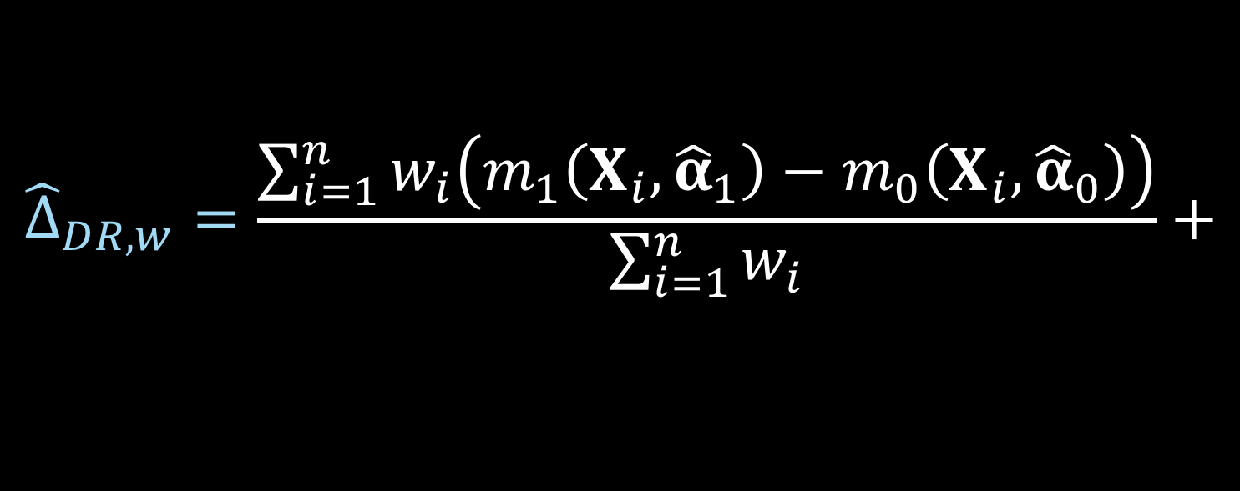


Doubly robust estimator
$${\hat{Δ}}_{DR, w}=\frac{\sum_{i=1}^{n}{w_{i}\left(m_{1}\left(X_{i},{\hat{α}}_{1}\right)−m_{0}\left(X_{i}, {\hat{α}}_{0}\right)\right)}}{\sum_{i=1}^{n}{w_{i}}}+$$
$$\frac{\sum_{i=1}^{n}{w_{i}Z_{i}\left(Y_{i}−m_{1}\left(X_{i}, {\hat{α}}_{1}\right)\right)}}{\sum_{i=1}^{n}{w_{i}}Z_{i}}−$$
$$\frac{\sum_{i=1}^{n}{w_{i}{(1−Z}_{i})\left(Y_{i}−m_{0}\left(X_{i}, {\hat{α}}_{0}\right)\right)}}{\sum_{i=1}^{n}{w_{i}}(1−Z_{i})}$$
Notes:
_click_ these ws are the weights we’ve just defined _click_
_click_ m1 is the predicted y value, calculated using the model built on the treated participants _click_
_click_ and m0 is the predicted y value, calculated using the model built on the participants assigned to the control group

Slide 40
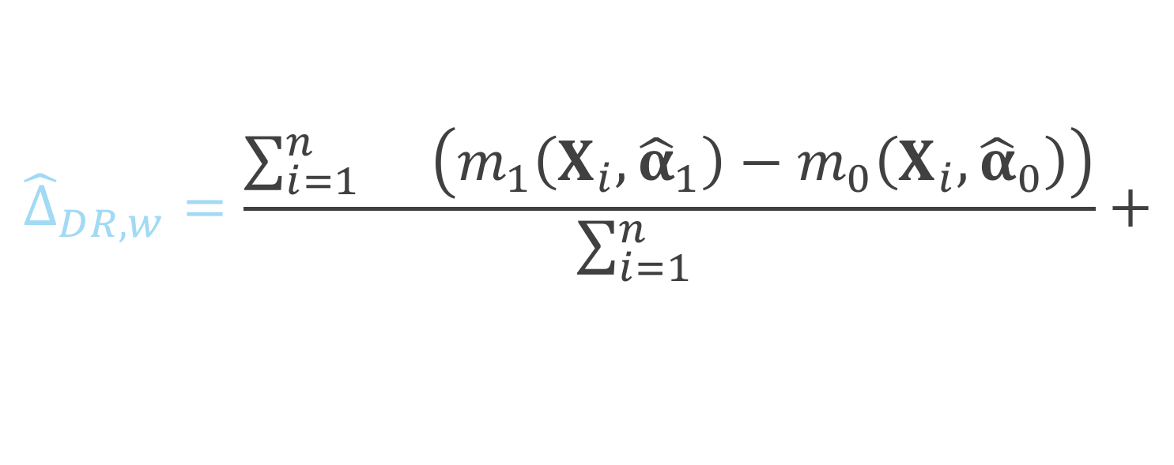
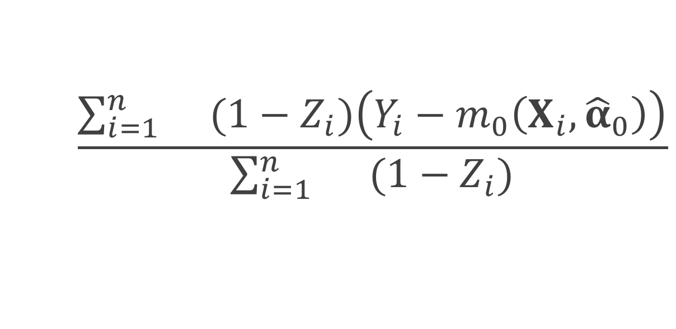
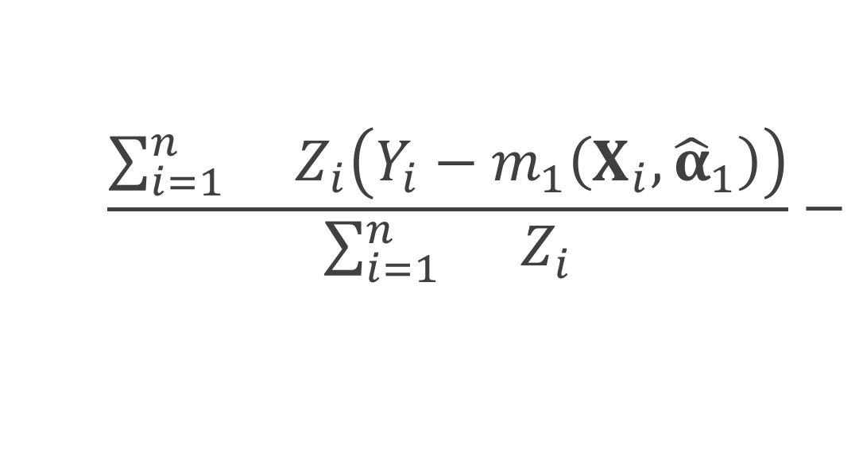
Doubly robust estimator
$${\hat{Δ}}_{DR, w}=\frac{\sum_{i=1}^{n}{w_{i}\left(m_{1}\left(X_{i},{\hat{α}}_{1}\right)−m_{0}\left(X_{i}, {\hat{α}}_{0}\right)\right)}}{\sum_{i=1}^{n}{w_{i}}}+$$
$$\frac{\sum_{i=1}^{n}{w_{i}Z_{i}\left(Y_{i}−m_{1}\left(X_{i}, {\hat{α}}_{1}\right)\right)}}{\sum_{i=1}^{n}{w_{i}}Z_{i}}−$$
$$\frac{\sum_{i=1}^{n}{w_{i}{(1−Z}_{i})\left(Y_{i}−m_{0}\left(X_{i}, {\hat{α}}_{0}\right)\right)}}{\sum_{i=1}^{n}{w_{i}}(1−Z_{i})}$$
Notes:
_click_ these ws are the weights we’ve just defined _click_
_click_ m1 is the predicted y value, calculated using the model built on the treated participants _click_
_click_ and m0 is the predicted y value, calculated using the model built on the participants assigned to the control group

Slide 41
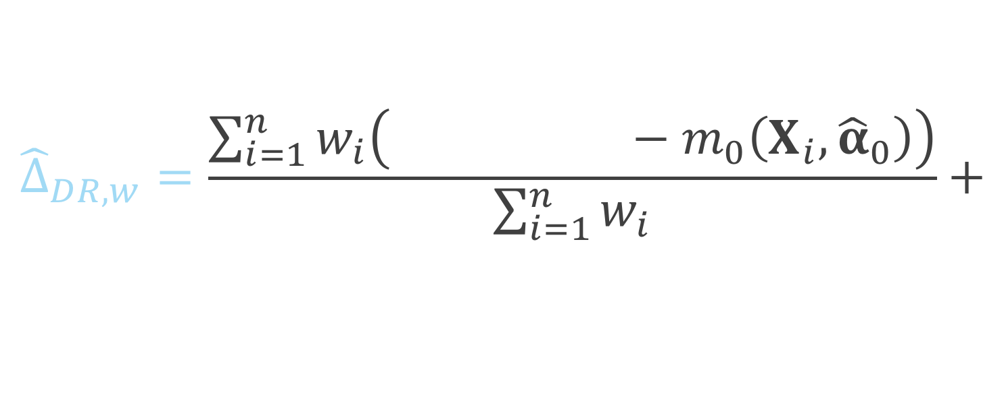
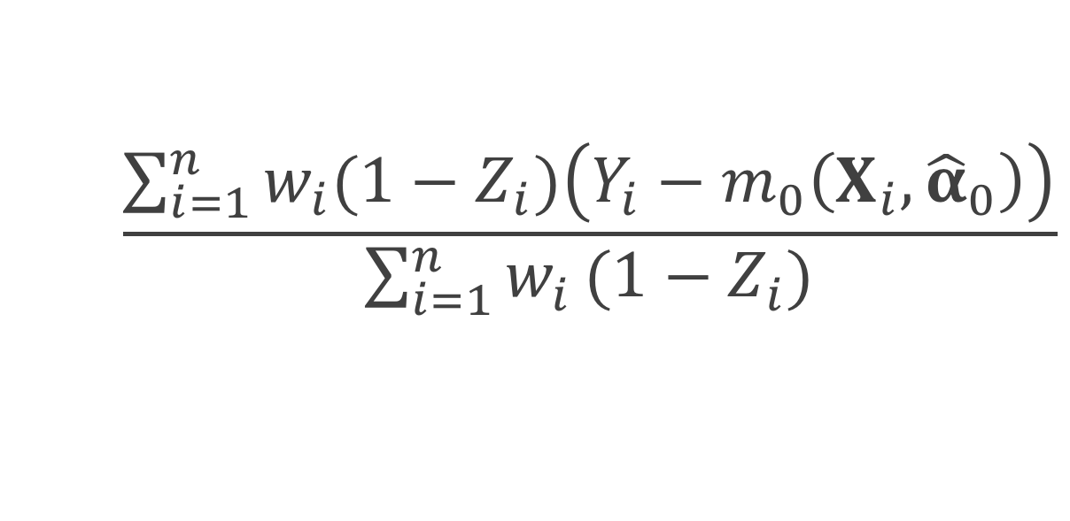
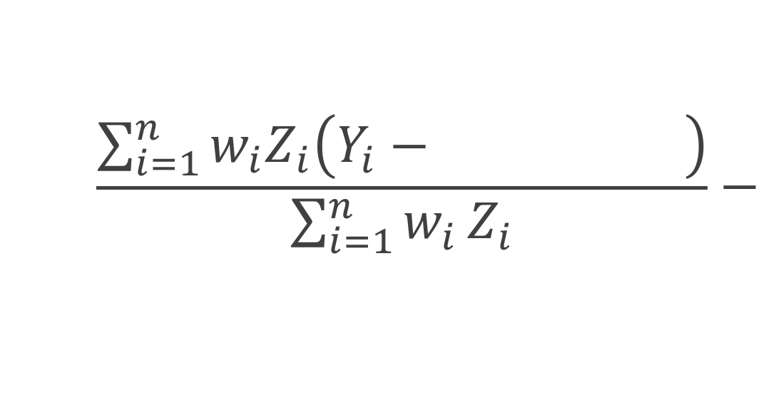
Doubly robust estimator
$${\hat{Δ}}_{DR, w}=\frac{\sum_{i=1}^{n}{w_{i}\left(m_{1}\left(X_{i},{\hat{α}}_{1}\right)−m_{0}\left(X_{i}, {\hat{α}}_{0}\right)\right)}}{\sum_{i=1}^{n}{w_{i}}}+$$
$$\frac{\sum_{i=1}^{n}{w_{i}Z_{i}\left(Y_{i}−m_{1}\left(X_{i}, {\hat{α}}_{1}\right)\right)}}{\sum_{i=1}^{n}{w_{i}}Z_{i}}−$$
$$\frac{\sum_{i=1}^{n}{w_{i}{(1−Z}_{i})\left(Y_{i}−m_{0}\left(X_{i}, {\hat{α}}_{0}\right)\right)}}{\sum_{i=1}^{n}{w_{i}}(1−Z_{i})}$$
Notes:
_click_ these ws are the weights we’ve just defined _click_
_click_ m1 is the predicted y value, calculated using the model built on the treated participants _click_
_click_ and m0 is the predicted y value, calculated using the model built on the participants assigned to the control group

Slide 42
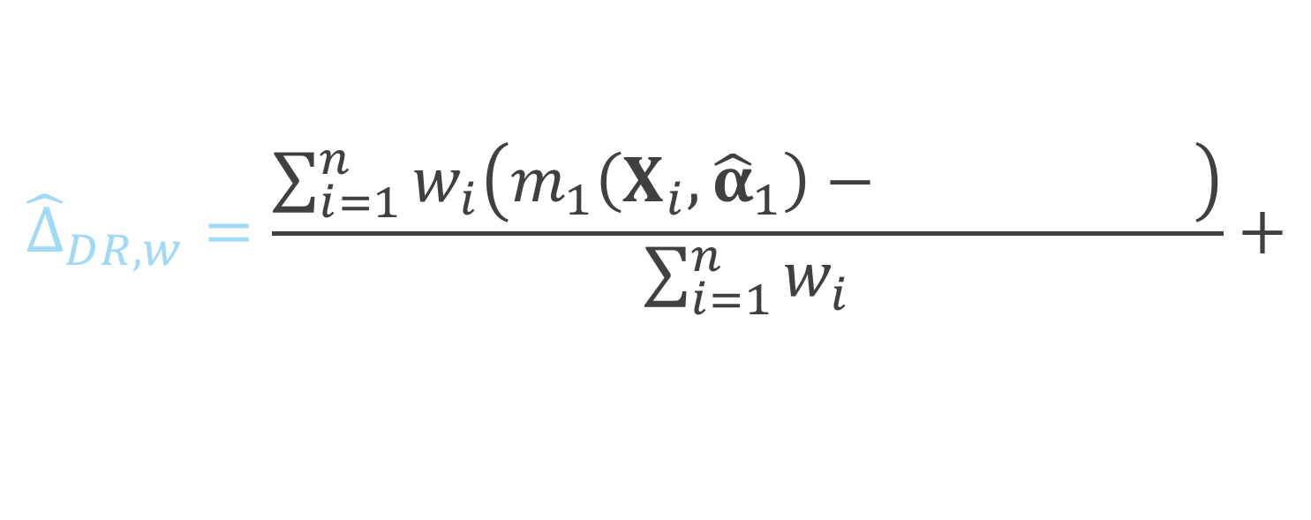
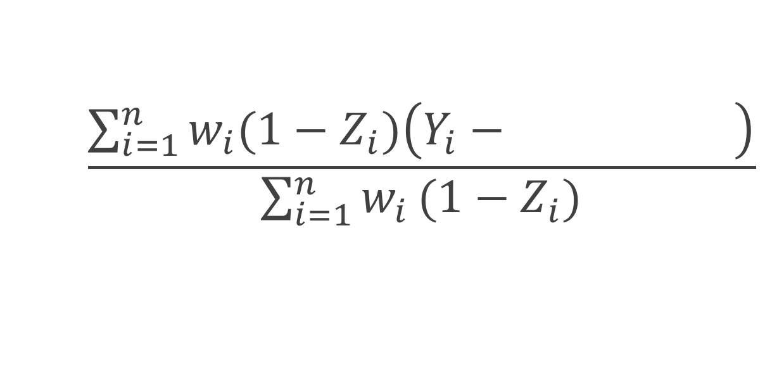
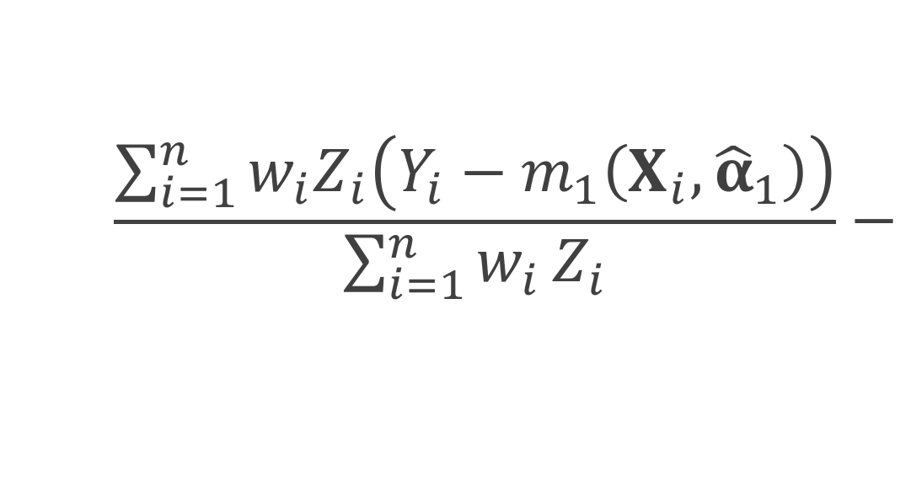
Doubly robust estimator
$${\hat{Δ}}_{DR, w}=\frac{\sum_{i=1}^{n}{w_{i}\left(m_{1}\left(X_{i},{\hat{α}}_{1}\right)−m_{0}\left(X_{i}, {\hat{α}}_{0}\right)\right)}}{\sum_{i=1}^{n}{w_{i}}}+$$
$$\frac{\sum_{i=1}^{n}{w_{i}Z_{i}\left(Y_{i}−m_{1}\left(X_{i}, {\hat{α}}_{1}\right)\right)}}{\sum_{i=1}^{n}{w_{i}}Z_{i}}−$$
$$\frac{\sum_{i=1}^{n}{w_{i}{(1−Z}_{i})\left(Y_{i}−m_{0}\left(X_{i}, {\hat{α}}_{0}\right)\right)}}{\sum_{i=1}^{n}{w_{i}}(1−Z_{i})}$$
Notes:
_click_ these ws are the weights we’ve just defined _click_
_click_ m1 is the predicted y value, calculated using the model built on the treated participants _click_
_click_ and m0 is the predicted y value, calculated using the model built on the participants assigned to the control group

Slide 43
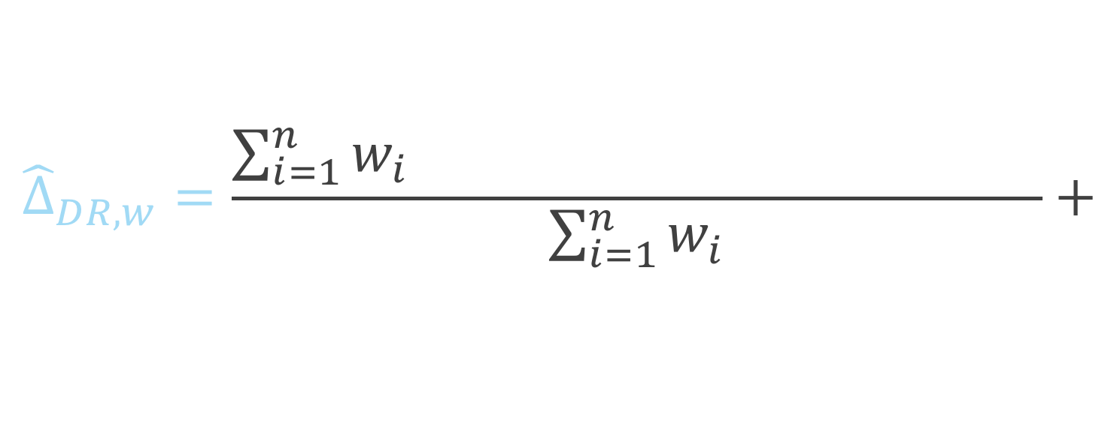
Doubly robust estimator
$${\hat{Δ}}_{DR, w}=\frac{\sum_{i=1}^{n}{w_{i}\left(m_{1}\left(X_{i},{\hat{α}}_{1}\right)−m_{0}\left(X_{i}, {\hat{α}}_{0}\right)\right)}}{\sum_{i=1}^{n}{w_{i}}}+$$
$$\frac{\sum_{i=1}^{n}{w_{i}Z_{i}\left(Y_{i}−m_{1}\left(X_{i}, {\hat{α}}_{1}\right)\right)}}{\sum_{i=1}^{n}{w_{i}}Z_{i}}−$$
$$\frac{\sum_{i=1}^{n}{w_{i}{(1−Z}_{i})\left(Y_{i}−m_{0}\left(X_{i}, {\hat{α}}_{0}\right)\right)}}{\sum_{i=1}^{n}{w_{i}}(1−Z_{i})}$$
Notes:
so here we have the difference between m1 and m0, so if the outcome model is correctly specified, this will be our quantity of interest

Slide 44
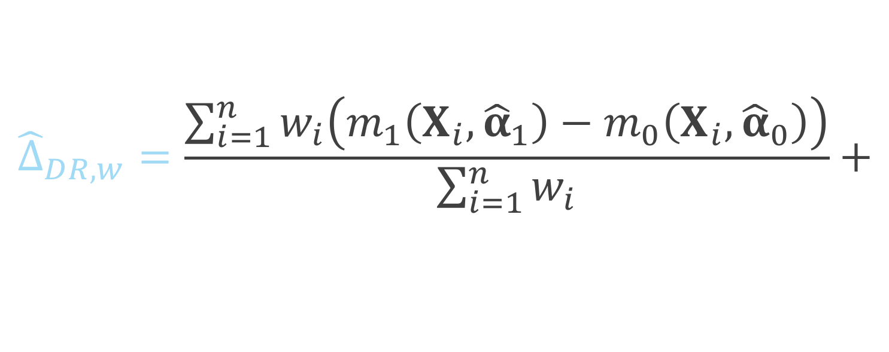
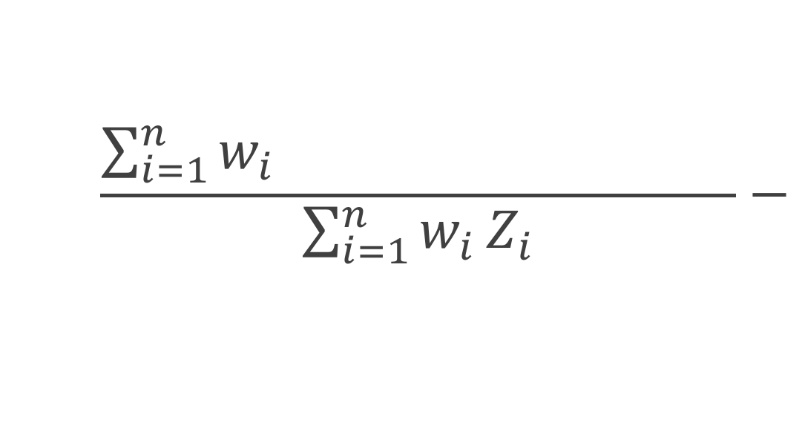
Doubly robust estimator
$${\hat{Δ}}_{DR, w}=\frac{\sum_{i=1}^{n}{w_{i}\left(m_{1}\left(X_{i},{\hat{α}}_{1}\right)−m_{0}\left(X_{i}, {\hat{α}}_{0}\right)\right)}}{\sum_{i=1}^{n}{w_{i}}}+$$
$$\frac{\sum_{i=1}^{n}{w_{i}Z_{i}\left(Y_{i}−m_{1}\left(X_{i}, {\hat{α}}_{1}\right)\right)}}{\sum_{i=1}^{n}{w_{i}}Z_{i}}−$$
$$\frac{\sum_{i=1}^{n}{w_{i}{(1−Z}_{i})\left(Y_{i}−m_{0}\left(X_{i}, {\hat{α}}_{0}\right)\right)}}{\sum_{i=1}^{n}{w_{i}}(1−Z_{i})}$$
Notes:
Here we have among the treated, the observed Y minus the predicted Y

Slide 45
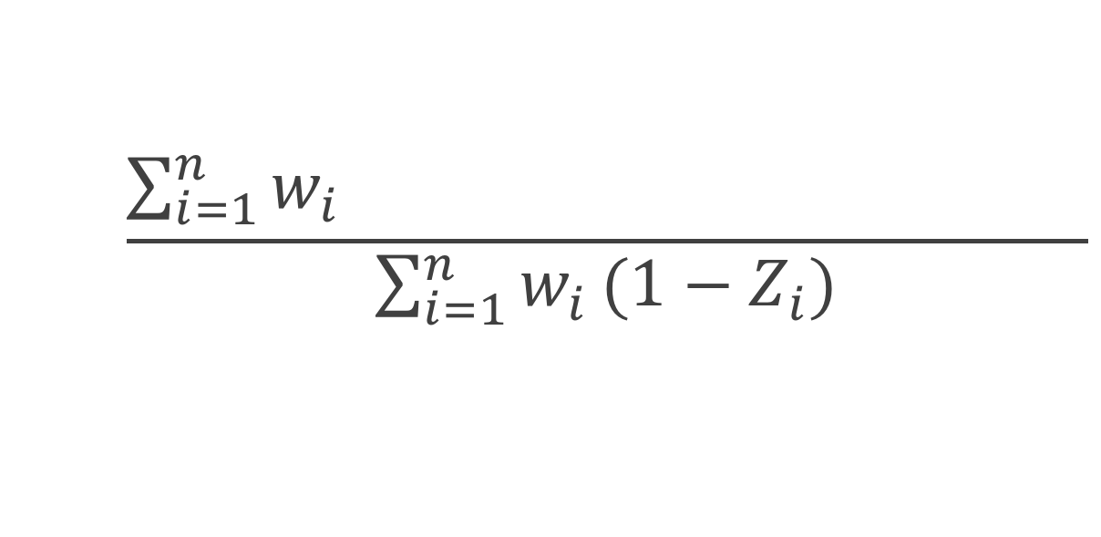
Doubly robust estimator
$${\hat{Δ}}_{DR, w}=\frac{\sum_{i=1}^{n}{w_{i}\left(m_{1}\left(X_{i},{\hat{α}}_{1}\right)−m_{0}\left(X_{i}, {\hat{α}}_{0}\right)\right)}}{\sum_{i=1}^{n}{w_{i}}}+$$
$$\frac{\sum_{i=1}^{n}{w_{i}Z_{i}\left(Y_{i}−m_{1}\left(X_{i}, {\hat{α}}_{1}\right)\right)}}{\sum_{i=1}^{n}{w_{i}}Z_{i}}−$$
$$\frac{\sum_{i=1}^{n}{w_{i}{(1−Z}_{i})\left(Y_{i}−m_{0}\left(X_{i}, {\hat{α}}_{0}\right)\right)}}{\sum_{i=1}^{n}{w_{i}}(1−Z_{i})}$$
Notes:
and similarly, among the controls we have the observed minus predicted y

Slide 46
Continuous outcome

Slide 47

Simulation
$$X \sim MVN\left(\left({0.5 \atop 1}\right), \left(\begin{matrix}2 & 1 \\ 1 & 1\end{matrix}\right)\right)$$
$$V \sim N \left(0, 1\right)$$
$$Z=\left\{\begin{aligned}1 0.5+0.25X_{1}+0.75X_{2}+V>0 \\ &0 o.w.\end{aligned}\right.$$
$$U \sim N(0, 1)$$
$$Y=1+Z+X_{1}+2X_{2}+U$$

Slide 51
Binary outcome

Slide 52

Simulation
$$X \sim MVN\left(\left({0.5 \atop 1}\right), \left(\begin{matrix}2 & 1 \\ 1 & 1\end{matrix}\right)\right)$$
$$V \sim logit \left(0, 1\right)$$
$$Z=\left\{\begin{aligned}1 0.5+0.25X_{1}+0.75X_{2}+V>0 \\ &0 o.w.\end{aligned}\right.$$
$$U \sim logit(0, 1)$$
$$Y=\left\{\begin{aligned}1 1+Z+X_{1}+2X_{2}+U>0 \\ &0 o.w.\end{aligned}\right.$$

Slide 57
Binary outcome (revised)

Slide 58

Simulation
$$X \sim MVN\left(\left({0.5 \atop 1}\right), \left(\begin{matrix}2 & 1 \\ 1 & 1\end{matrix}\right)\right)$$
$$V \sim N \left(0, 1\right)$$
$$Z=\left\{\begin{aligned}1 0.5+0.25X_{1}+0.75X_{2}+V>0 \\ &0 o.w.\end{aligned}\right.$$
$$U \sim logit(0, 1)$$
$$Y=\left\{\begin{aligned}1 1+3Z+X_{1}+2X_{2}+U>0 \\ &0 o.w.\end{aligned}\right.$$

Slide 59
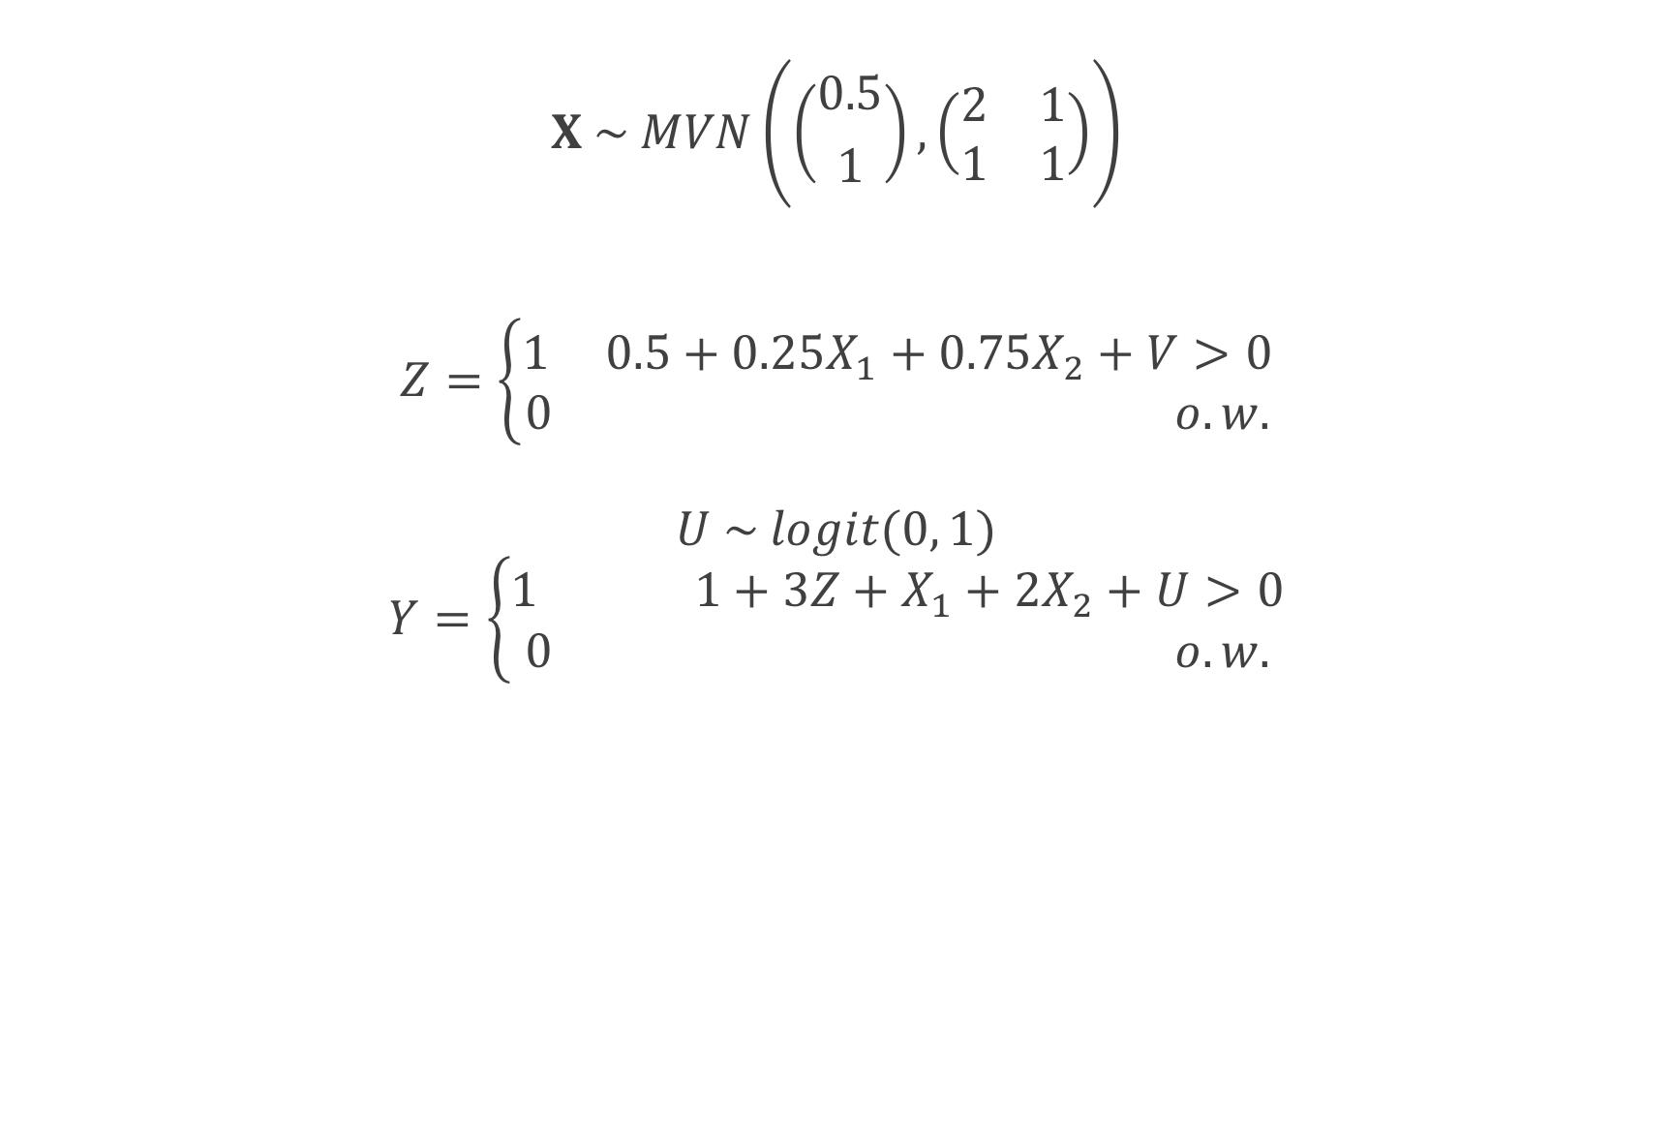
Simulation
$$X \sim MVN\left(\left({0.5 \atop 1}\right), \left(\begin{matrix}2 & 1 \\ 1 & 1\end{matrix}\right)\right)$$
$$V \sim N \left(0, 1\right)$$
$$Z=\left\{\begin{aligned}1 0.5+0.25X_{1}+0.75X_{2}+V>0 \\ &0 o.w.\end{aligned}\right.$$
$$U \sim logit(0, 1)$$
$$Y=\left\{\begin{aligned}1 1+3Z+X_{1}+2X_{2}+U>0 \\ &0 o.w.\end{aligned}\right.$$

Slide 60
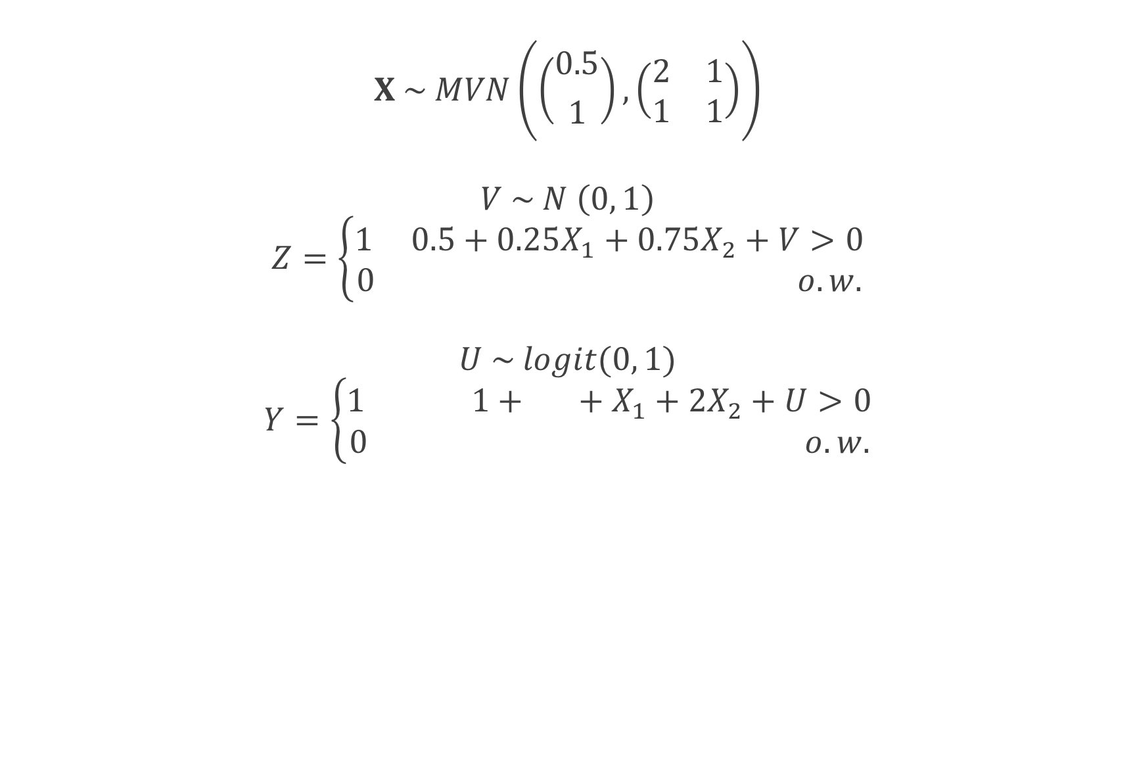
Simulation
$$X \sim MVN\left(\left({0.5 \atop 1}\right), \left(\begin{matrix}2 & 1 \\ 1 & 1\end{matrix}\right)\right)$$
$$V \sim N \left(0, 1\right)$$
$$Z=\left\{\begin{aligned}1 0.5+0.25X_{1}+0.75X_{2}+V>0 \\ &0 o.w.\end{aligned}\right.$$
$$U \sim logit(0, 1)$$
$$Y=\left\{\begin{aligned}1 1+3Z+X_{1}+2X_{2}+U>0 \\ &0 o.w.\end{aligned}\right.$$

Slide 65
Standard errors

Slide 68
Recap
Replicated the finite-sample bias seen by Freedman and Berk using the ATE weights
ATM and ATO weights had improved finite-sample properties
The variance for the ATO and ATM is preferable to that of the ATE

Slide 69
Q&A

Slide 70
Doubly robust and large sample variance estimator for overlap weights

Slide 71

ATO estimator
$$\frac{\sum_{i=1}^{n}{\left(1−e\left(X_{i}, \hat{β}\right)\right)Z_{i}Y_{i}}}{\sum_{i=1}^{n}{\left(1−e\left(X_{i}, \hat{β}\right)\right)Z_{i}}}−\frac{\sum_{i=1}^{n}{e\left(X_{i}, \hat{β}\right){(1−Z}_{i})Y_{i}}}{\sum_{i=1}^{n}{e\left(X_{i}, \hat{β}\right)(1−Z_{i})}}$$

Slide 72
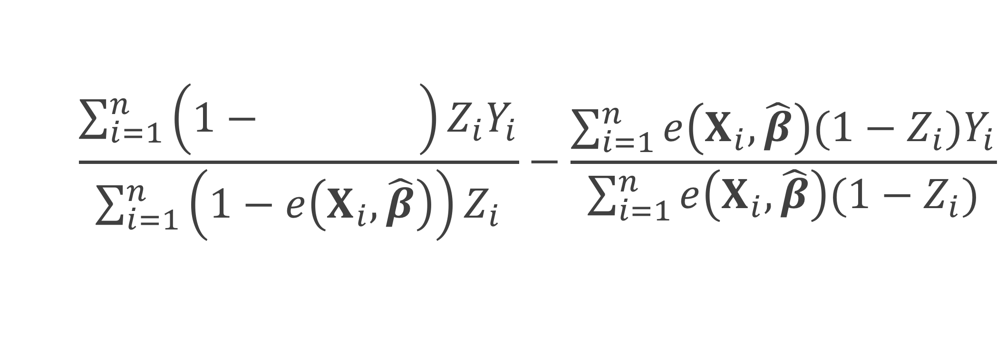
ATO estimator
$$\frac{\sum_{i=1}^{n}{\left(1−e\left(X_{i}, \hat{β}\right)\right)Z_{i}Y_{i}}}{\sum_{i=1}^{n}{\left(1−e\left(X_{i}, \hat{β}\right)\right)Z_{i}}}−\frac{\sum_{i=1}^{n}{e\left(X_{i}, \hat{β}\right){(1−Z}_{i})Y_{i}}}{\sum_{i=1}^{n}{e\left(X_{i}, \hat{β}\right)(1−Z_{i})}}$$
Notes:
Here I represent the fitted propensity score by e(Xi, beta hat) – this is often estimated by fitting a propensity score model using a logistic regression. Xi are the covariate values for participant I, beta hat are the betas obtained from the propensity score model.

Slide 73
ATO estimator
$$\frac{\sum_{i=1}^{n}{\left(1−e\left(X_{i}, \hat{β}\right)\right)Z_{i}Y_{i}}}{\sum_{i=1}^{n}{\left(1−e\left(X_{i}, \hat{β}\right)\right)Z_{i}}}−\frac{\sum_{i=1}^{n}{e\left(X_{i}, \hat{β}\right){(1−Z}_{i})Y_{i}}}{\sum_{i=1}^{n}{e\left(X_{i}, \hat{β}\right)(1−Z_{i})}}$$

Slide 74
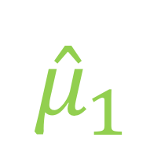
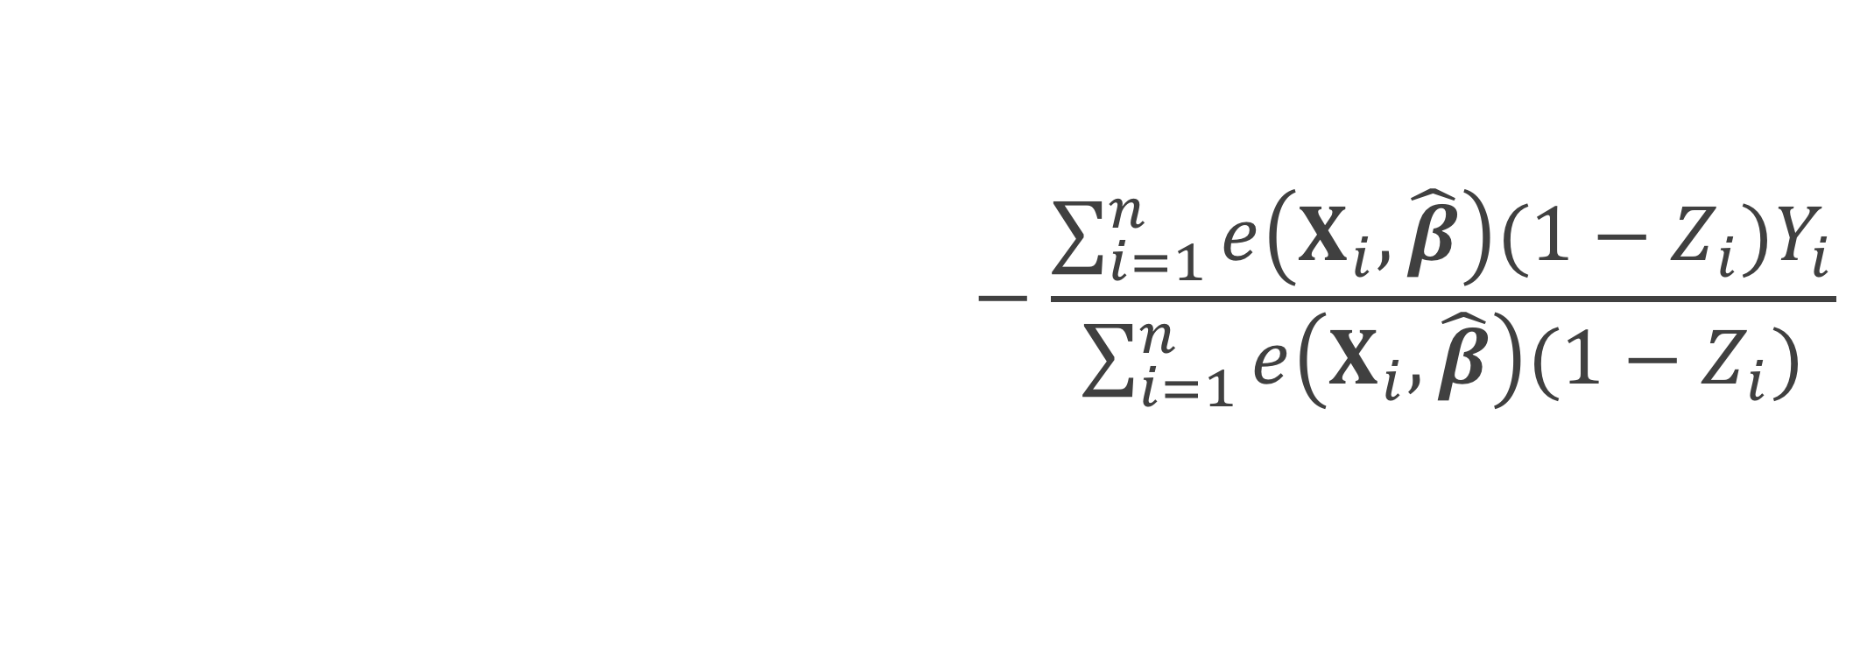
ATO estimator
$$\frac{\sum_{i=1}^{n}{\left(1−e\left(X_{i}, \hat{β}\right)\right)Z_{i}Y_{i}}}{\sum_{i=1}^{n}{\left(1−e\left(X_{i}, \hat{β}\right)\right)Z_{i}}}−\frac{\sum_{i=1}^{n}{e\left(X_{i}, \hat{β}\right){(1−Z}_{i})Y_{i}}}{\sum_{i=1}^{n}{e\left(X_{i}, \hat{β}\right)(1−Z_{i})}}$$
$${\hat{μ}}_{1}$$

Slide 75

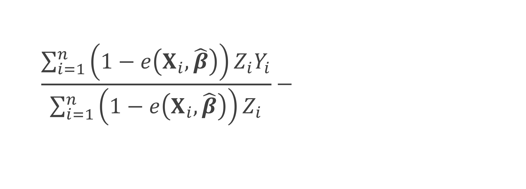

ATO estimator
$$\frac{\sum_{i=1}^{n}{\left(1−e\left(X_{i}, \hat{β}\right)\right)Z_{i}Y_{i}}}{\sum_{i=1}^{n}{\left(1−e\left(X_{i}, \hat{β}\right)\right)Z_{i}}}−\frac{\sum_{i=1}^{n}{e\left(X_{i}, \hat{β}\right){(1−Z}_{i})Y_{i}}}{\sum_{i=1}^{n}{e\left(X_{i}, \hat{β}\right)(1−Z_{i})}}$$
$${\hat{μ}}_{1}$$
$${\hat{μ}}_{0}$$

Slide 76
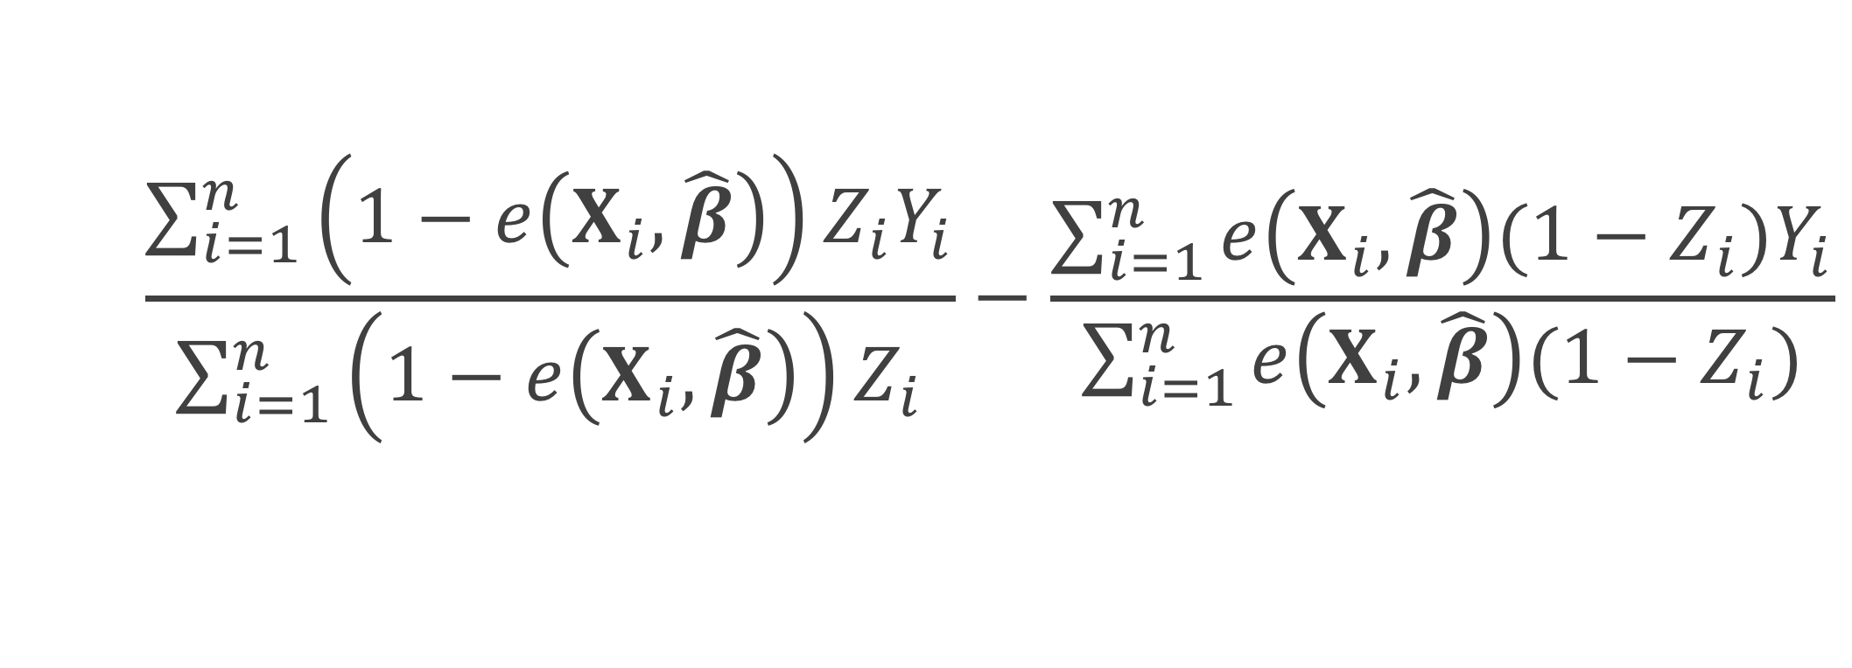

ATO estimator
$$\frac{\sum_{i=1}^{n}{\left(1−e\left(X_{i}, \hat{β}\right)\right)Z_{i}Y_{i}}}{\sum_{i=1}^{n}{\left(1−e\left(X_{i}, \hat{β}\right)\right)Z_{i}}}−\frac{\sum_{i=1}^{n}{e\left(X_{i}, \hat{β}\right){(1−Z}_{i})Y_{i}}}{\sum_{i=1}^{n}{e\left(X_{i}, \hat{β}\right)(1−Z_{i})}}$$
$${\hat{μ}}_{1}$$
$$−$$
$${\hat{μ}}_{0}$$

Slide 77
How to
Plug in
Fit a weighted generalized linear model Y ~ Z

Slide 78
How to
Plug in
Fit a weighted generalized linear model Y ~ Z
But what about the variance?
Pull from the GLM?
Robust standard errors? (sandwich estimator)
Notes:
These robust standard errors do no take into account the fact that you fit a propensity score prior to fitting your weighted GLM

Slide 79
Williamson 2013
“
…ignoring the estimation of the propensity score in the calculation of the variance leads to the erroneous conclusion that the IPTW treatment effect estimator has the same variance as an unadjusted estimator; thus, it is important to use a variance estimator that correctly takes into account the estimation of the propensity score.
”

Slide 80


ATO estimator
ATO weight
$$u\left(θ\right)=\left(\begin{matrix}\left(Y−μ_{1}\right)Z\left(1−e\left(X, β\right)\right) \\ \left(Y−μ_{0}\right)\left(1−Z\right)e\left(X, β\right) \\ X\left(Z−e\left(X, β\right)\right)\end{matrix}\right)$$
$$θ={\left(μ_{1}, μ_{0},β^{T}\right)}^{T}$$

Slide 81

Sandwich estimator
$$var\left(θ\right)=A^{−1}BA^{−T}$$

Slide 82

Sandwich estimator
$$var\left(θ\right)=A^{−1}BA^{−T}$$
$$A=−E\left[\frac{∂u\left(θ\right)}{∂θ}\right]$$

Slide 83


$$θ={\left(μ_{1}, μ_{0},β^{T}\right)}^{T}$$
$$u\left(θ\right)=\left(\begin{matrix}\left(Y−μ_{1}\right)Z\left(1−e\left(X, β\right)\right) \\ \left(Y−μ_{0}\right)\left(1−Z\right)e\left(X, β\right) \\ X\left(Z−e\left(X, β\right)\right)\end{matrix}\right)$$
$$A=−E\left[\frac{∂u\left(θ\right)}{∂θ}\right]$$

Slide 84
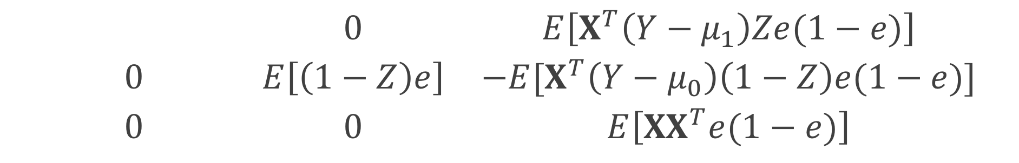
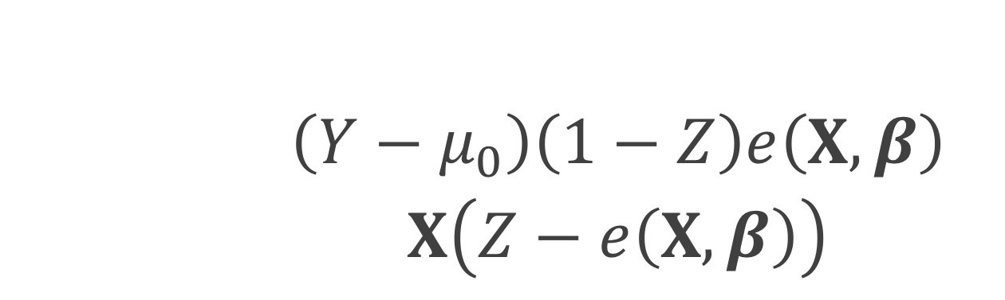
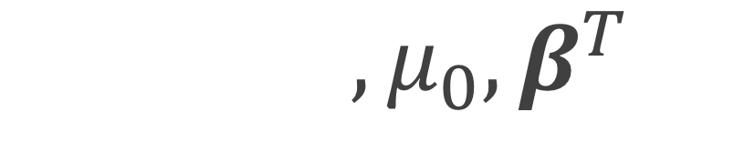
$$θ={\left(μ_{1}, μ_{0},β^{T}\right)}^{T}$$
$$u\left(θ\right)=\left(\begin{matrix}\left(Y−μ_{1}\right)Z\left(1−e\left(X, β\right)\right) \\ \left(Y−μ_{0}\right)\left(1−Z\right)e\left(X, β\right) \\ X\left(Z−e\left(X, β\right)\right)\end{matrix}\right)$$
$$\left(\begin{matrix}E\left[Z(1−e)\right] & 0 & E\left[X^{T}\left(Y−μ_{1}\right)Ze(1−e)\right] \\ 0 & E\left[\left(1−Z\right)e\right] & −E[X^{T}\left(Y−μ_{0}\right)\left(1−Z\right)e(1−e)] \\ 0 & 0 & E\left[{XX}^{T}e(1−e)\right]\end{matrix}\right)$$

Slide 85
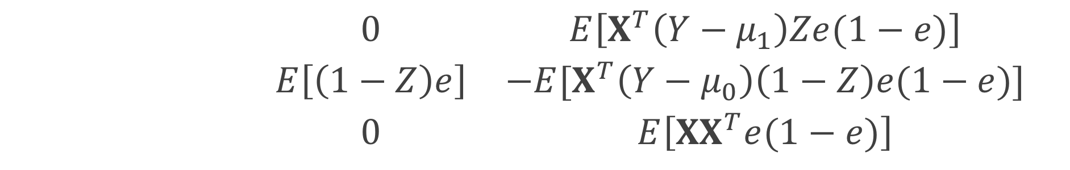
$$θ={\left(μ_{1}, μ_{0},β^{T}\right)}^{T}$$
$$u\left(θ\right)=\left(\begin{matrix}\left(Y−μ_{1}\right)Z\left(1−e\left(X, β\right)\right) \\ \left(Y−μ_{0}\right)\left(1−Z\right)e\left(X, β\right) \\ X\left(Z−e\left(X, β\right)\right)\end{matrix}\right)$$
$$\left(\begin{matrix}E\left[Z(1−e)\right] & 0 & E\left[X^{T}\left(Y−μ_{1}\right)Ze(1−e)\right] \\ 0 & E\left[\left(1−Z\right)e\right] & −E[X^{T}\left(Y−μ_{0}\right)\left(1−Z\right)e(1−e)] \\ 0 & 0 & E\left[{XX}^{T}e(1−e)\right]\end{matrix}\right)$$

Slide 86
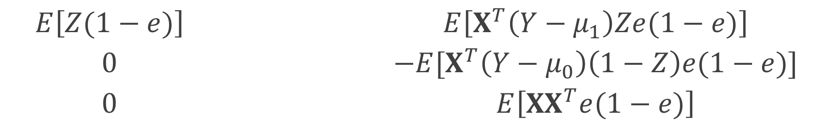
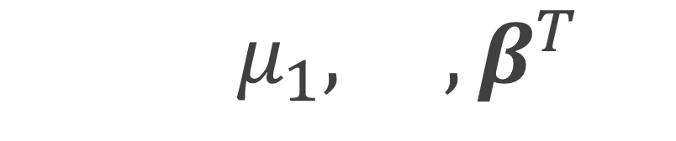
$$θ={\left(μ_{1}, μ_{0},β^{T}\right)}^{T}$$
$$u\left(θ\right)=\left(\begin{matrix}\left(Y−μ_{1}\right)Z\left(1−e\left(X, β\right)\right) \\ \left(Y−μ_{0}\right)\left(1−Z\right)e\left(X, β\right) \\ X\left(Z−e\left(X, β\right)\right)\end{matrix}\right)$$
$$\left(\begin{matrix}E\left[Z(1−e)\right] & 0 & E\left[X^{T}\left(Y−μ_{1}\right)Ze(1−e)\right] \\ 0 & E\left[\left(1−Z\right)e\right] & −E[X^{T}\left(Y−μ_{0}\right)\left(1−Z\right)e(1−e)] \\ 0 & 0 & E\left[{XX}^{T}e(1−e)\right]\end{matrix}\right)$$

Slide 87
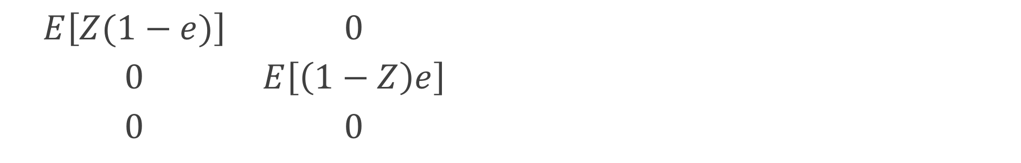
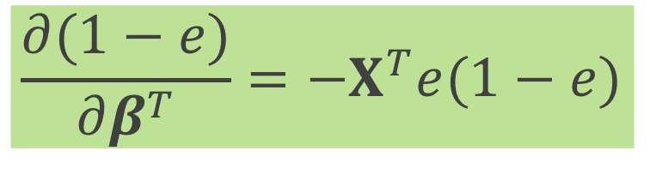
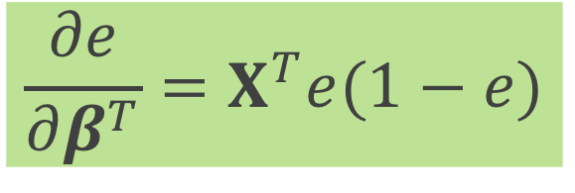

$$θ={\left(μ_{1}, μ_{0},β^{T}\right)}^{T}$$
$$u\left(θ\right)=\left(\begin{matrix}\left(Y−μ_{1}\right)Z\left(1−e\left(X, β\right)\right) \\ \left(Y−μ_{0}\right)\left(1−Z\right)e\left(X, β\right) \\ X\left(Z−e\left(X, β\right)\right)\end{matrix}\right)$$
$$\frac{∂e}{∂β^{T}}=X^{T}e(1−e)$$
$$\left(\begin{matrix}E\left[Z(1−e)\right] & 0 & E\left[X^{T}\left(Y−μ_{1}\right)Ze(1−e)\right] \\ 0 & E\left[\left(1−Z\right)e\right] & −E[X^{T}\left(Y−μ_{0}\right)\left(1−Z\right)e(1−e)] \\ 0 & 0 & E\left[{XX}^{T}e(1−e)\right]\end{matrix}\right)$$
$$\frac{∂(1−e)}{∂β^{T}}={−X}^{T}e(1−e)$$

Slide 88

Sandwich estimator
$$var\left(θ\right)=A^{−1}BA^{−T}$$
$B=E\left[u\left(θ\right)u{\left(θ\right)}^{T}\right]$

Slide 89



$B=E\left[u\left(θ\right)u{\left(θ\right)}^{T}\right]$
$$B=E\left[\left(\begin{matrix}\left(Y−μ_{1}\right)Z\left(1−e\left(X, β\right)\right) \\ \left(Y−μ_{0}\right)\left(1−Z\right)e\left(X, β\right) \\ X\left(Z−e\left(X, β\right)\right)\end{matrix}\right)× \right.$$
$$\left.{\left(\begin{matrix}\left(Y−μ_{1}\right)Z\left(1−e\left(X, β\right)\right) \\ \left(Y−μ_{0}\right)\left(1−Z\right)e\left(X, β\right) \\ X\left(Z−e\left(X, β\right)\right)\end{matrix}\right)}^{T}\right]$$

Slide 90

Sandwich estimator
$$\hat{var}\left(\hat{θ}\right)=\frac{1}{n}{{\hat{A}}_{n}}^{−1}{\hat{B}}_{n}{{\hat{A}}_{n}}^{−T}$$
Notes:
We can replace the expectations by the sample average to get an approximate large sample variance

Slide 91

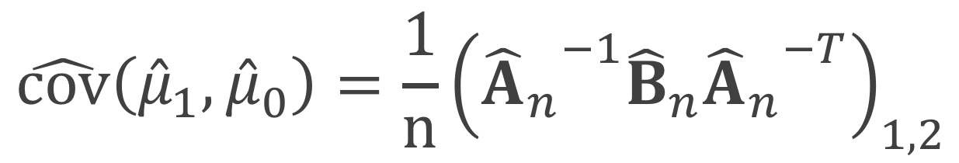
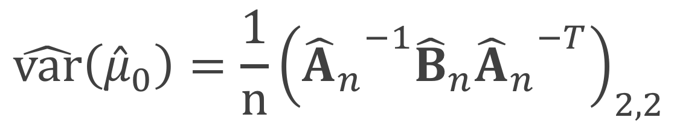
Sandwich estimator
$$\hat{var}\left({\hat{μ}}_{1}\right)=\frac{1}{n}{\left({{\hat{A}}_{n}}^{−1}{\hat{B}}_{n}{{\hat{A}}_{n}}^{−T}\right)}_{1,1}$$
$$\hat{var}\left({\hat{μ}}_{0}\right)=\frac{1}{n}{\left({{\hat{A}}_{n}}^{−1}{\hat{B}}_{n}{{\hat{A}}_{n}}^{−T}\right)}_{2,2}$$
$$\hat{cov}\left({{\hat{μ}}_{1},\hat{μ}}_{0}\right)=\frac{1}{n}{\left({{\hat{A}}_{n}}^{−1}{\hat{B}}_{n}{{\hat{A}}_{n}}^{−T}\right)}_{1,2}$$

Slide 92
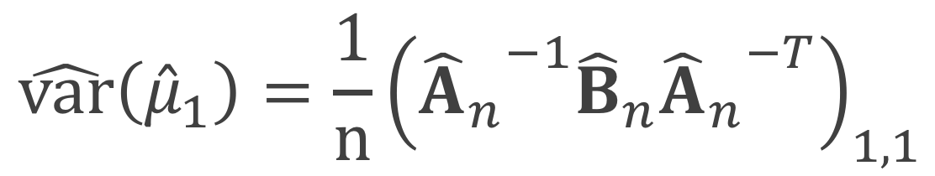

Sandwich estimator
$$\hat{var}\left({\hat{μ}}_{1}\right)=\frac{1}{n}{\left({{\hat{A}}_{n}}^{−1}{\hat{B}}_{n}{{\hat{A}}_{n}}^{−T}\right)}_{1,1}$$
$$\hat{var}\left({\hat{μ}}_{0}\right)=\frac{1}{n}{\left({{\hat{A}}_{n}}^{−1}{\hat{B}}_{n}{{\hat{A}}_{n}}^{−T}\right)}_{2,2}$$
$$\hat{cov}\left({{\hat{μ}}_{1},\hat{μ}}_{0}\right)=\frac{1}{n}{\left({{\hat{A}}_{n}}^{−1}{\hat{B}}_{n}{{\hat{A}}_{n}}^{−T}\right)}_{1,2}$$

Slide 93

Sandwich estimator
$$\hat{var}\left({\hat{μ}}_{1}\right)=\frac{1}{n}{\left({{\hat{A}}_{n}}^{−1}{\hat{B}}_{n}{{\hat{A}}_{n}}^{−T}\right)}_{1,1}$$
$$\hat{var}\left({\hat{μ}}_{0}\right)=\frac{1}{n}{\left({{\hat{A}}_{n}}^{−1}{\hat{B}}_{n}{{\hat{A}}_{n}}^{−T}\right)}_{2,2}$$
$$\hat{cov}\left({{\hat{μ}}_{1},\hat{μ}}_{0}\right)=\frac{1}{n}{\left({{\hat{A}}_{n}}^{−1}{\hat{B}}_{n}{{\hat{A}}_{n}}^{−T}\right)}_{1,2}$$

Slide 94
Sandwich estimator
$$\hat{var}\left({\hat{μ}}_{1}\right)=\frac{1}{n}{\left({{\hat{A}}_{n}}^{−1}{\hat{B}}_{n}{{\hat{A}}_{n}}^{−T}\right)}_{1,1}$$
$$\hat{var}\left({\hat{μ}}_{0}\right)=\frac{1}{n}{\left({{\hat{A}}_{n}}^{−1}{\hat{B}}_{n}{{\hat{A}}_{n}}^{−T}\right)}_{2,2}$$
$$\hat{cov}\left({{\hat{μ}}_{1},\hat{μ}}_{0}\right)=\frac{1}{n}{\left({{\hat{A}}_{n}}^{−1}{\hat{B}}_{n}{{\hat{A}}_{n}}^{−T}\right)}_{1,2}$$

Slide 95
What if we want to also adjust the outcome model?

Slide 96
How to
Fit a weighted generalized linear model Y ~ Z + X
Doubly robust estimator
Notes:
Fit a single weighted generalized linear model, with the Xs included – this is commonly what I have seen done in the literature – under the continuous case, using a GLM with a identity link, this is essentially a doubly robust estimator
Use a doubly robust estimator where we fit two models, one among the treated and one among the controls and combine them using the weights

Slide 97
How to
Fit a weighted generalized linear model Y ~ Z + X
Doubly robust estimator
But what about the variance?
Pull from the GLM?
Robust standard errors? (sandwich estimator)
Notes:
But what about the variance? Again if we are fitting a single model, we can pull the variances directly from the GLM or we can use robust standard errors, however the robust standard errors from a GLM won’t incorporate the fact that the propensity scores are not fixed. Alternatively, we can use the doubly robust estimator and fit an updated large-sample variance that incorporates the propensity score model

Slide 98

ATO DR estimator
$${\hat{Δ}}_{DR, ATO}={\hat{δ}}_{1}+{\hat{δ}}_{2}−{\hat{δ}}_{3}$$
Notes:
We can write the doubly robust estimator for the ATO in 3 equations, delta 1, delta2 and delta 3

Slide 99
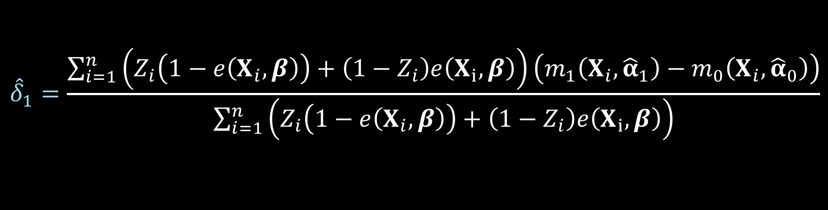
ATO DR estimator
$${\hat{Δ}}_{DR, ATO}={\hat{δ}}_{1}+{\hat{δ}}_{2}−{\hat{δ}}_{3}$$
$${\hat{δ}}_{1}=\frac{\sum_{i=1}^{n}{\left(Z_{i}\left(1−e\left(X_{i},β\right)\right)+\left(1−Z_{i}\right)e\left(X_{i}, β\right)\right)\left(m_{1}\left(X_{i},{\hat{α}}_{1}\right)−m_{0}\left(X_{i}, {\hat{α}}_{0}\right)\right)}}{\sum_{i=1}^{n}{\left(Z_{i}\left(1−e\left(X_{i},β\right)\right)+\left(1−Z_{i}\right)e\left(X_{i}, β\right)\right)}}$$
Notes:
Here is delta 1

Slide 100
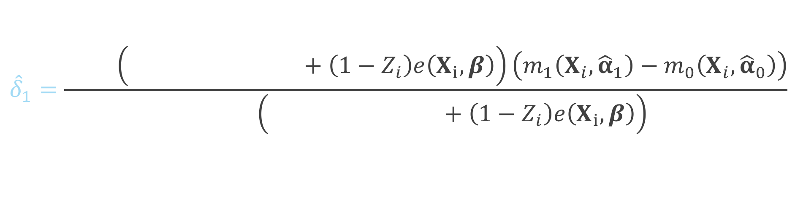
ATO DR estimator
$${\hat{Δ}}_{DR, ATO}={\hat{δ}}_{1}+{\hat{δ}}_{2}−{\hat{δ}}_{3}$$
$${\hat{δ}}_{1}=\frac{\sum_{i=1}^{n}{\left(Z_{i}\left(1−e\left(X_{i},β\right)\right)+\left(1−Z_{i}\right)e\left(X_{i}, β\right)\right)\left(m_{1}\left(X_{i},{\hat{α}}_{1}\right)−m_{0}\left(X_{i}, {\hat{α}}_{0}\right)\right)}}{\sum_{i=1}^{n}{\left(Z_{i}\left(1−e\left(X_{i},β\right)\right)+\left(1−Z_{i}\right)e\left(X_{i}, β\right)\right)}}$$
Notes:
This will be weighted by 1 minus the propensity score for the treated

Slide 101
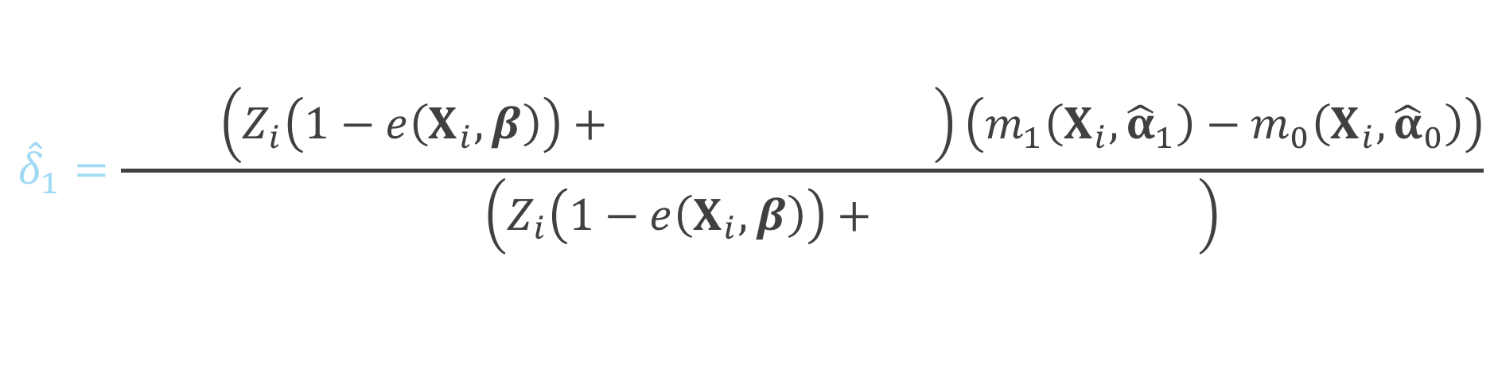
ATO DR estimator
$${\hat{Δ}}_{DR, ATO}={\hat{δ}}_{1}+{\hat{δ}}_{2}−{\hat{δ}}_{3}$$
$${\hat{δ}}_{1}=\frac{\sum_{i=1}^{n}{\left(Z_{i}\left(1−e\left(X_{i},β\right)\right)+\left(1−Z_{i}\right)e\left(X_{i}, β\right)\right)\left(m_{1}\left(X_{i},{\hat{α}}_{1}\right)−m_{0}\left(X_{i}, {\hat{α}}_{0}\right)\right)}}{\sum_{i=1}^{n}{\left(Z_{i}\left(1−e\left(X_{i},β\right)\right)+\left(1−Z_{i}\right)e\left(X_{i}, β\right)\right)}}$$
Notes:
And the propensity score for the controls

Slide 102
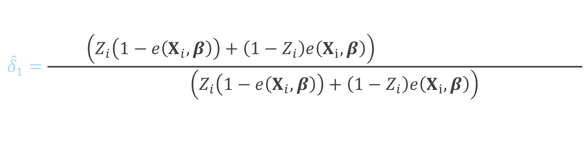
ATO DR estimator
$${\hat{Δ}}_{DR, ATO}={\hat{δ}}_{1}+{\hat{δ}}_{2}−{\hat{δ}}_{3}$$
$${\hat{δ}}_{1}=\frac{\sum_{i=1}^{n}{\left(Z_{i}\left(1−e\left(X_{i},β\right)\right)+\left(1−Z_{i}\right)e\left(X_{i}, β\right)\right)\left(m_{1}\left(X_{i},{\hat{α}}_{1}\right)−m_{0}\left(X_{i}, {\hat{α}}_{0}\right)\right)}}{\sum_{i=1}^{n}{\left(Z_{i}\left(1−e\left(X_{i},β\right)\right)+\left(1−Z_{i}\right)e\left(X_{i}, β\right)\right)}}$$
Notes:
Here is the difference between the Y predicted among the treated and the Y predicted among the controls

Slide 103
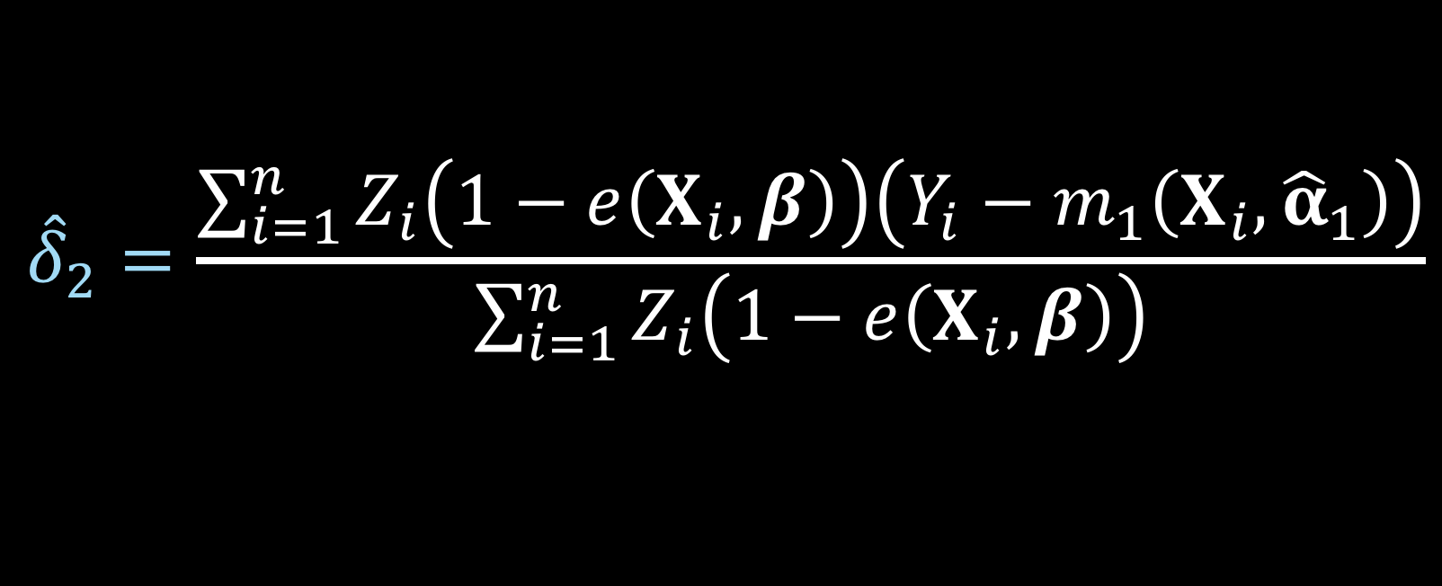
ATO DR estimator
$${\hat{Δ}}_{DR, ATO}={\hat{δ}}_{1}+{\hat{δ}}_{2}−{\hat{δ}}_{3}$$
$${\hat{δ}}_{2}=\frac{\sum_{i=1}^{n}{Z_{i}\left(1−e\left(X_{i},β\right)\right)\left(Y_{i}−m_{1}\left(X_{i},{\hat{α}}_{1}\right)\right)}}{\sum_{i=1}^{n}{Z_{i}\left(1−e\left(X_{i},β\right)\right)}}$$
Notes:
Here is delta 2

Slide 104
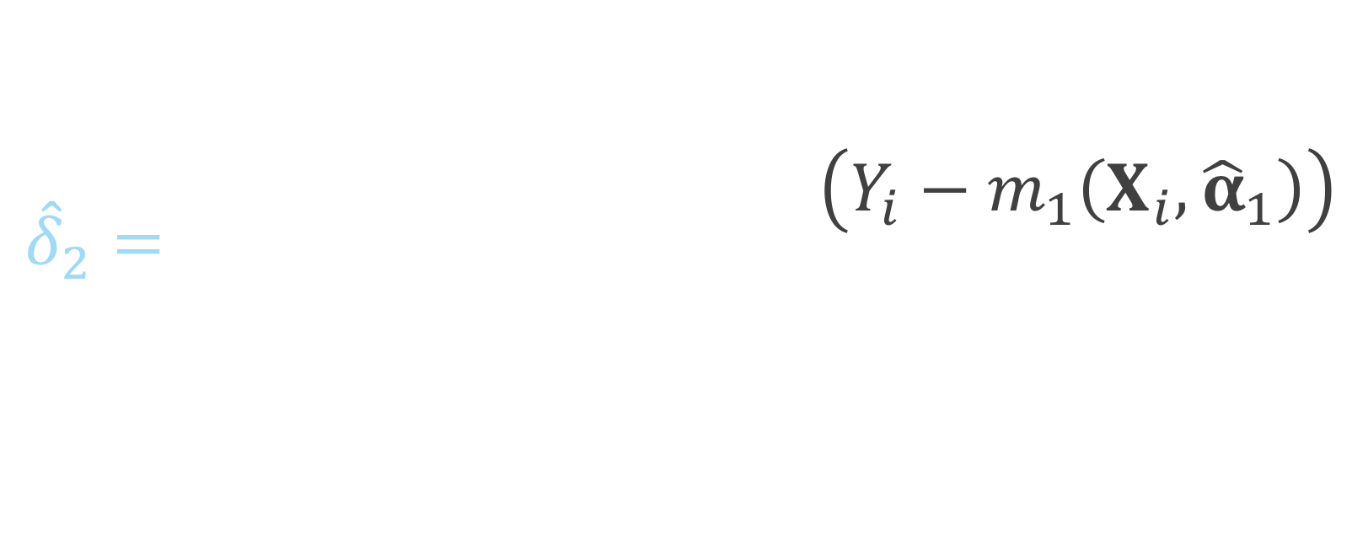
ATO DR estimator
$${\hat{Δ}}_{DR, ATO}={\hat{δ}}_{1}+{\hat{δ}}_{2}−{\hat{δ}}_{3}$$
$${\hat{δ}}_{2}=\frac{\sum_{i=1}^{n}{Z_{i}\left(1−e\left(X_{i},β\right)\right)\left(Y_{i}−m_{1}\left(X_{i},{\hat{α}}_{1}\right)\right)}}{\sum_{i=1}^{n}{Z_{i}\left(1−e\left(X_{i},β\right)\right)}}$$
Notes:
Notice this is just among the treated, so if the subject i is in the control group, this will be zero, since Zi will be 0

Slide 105
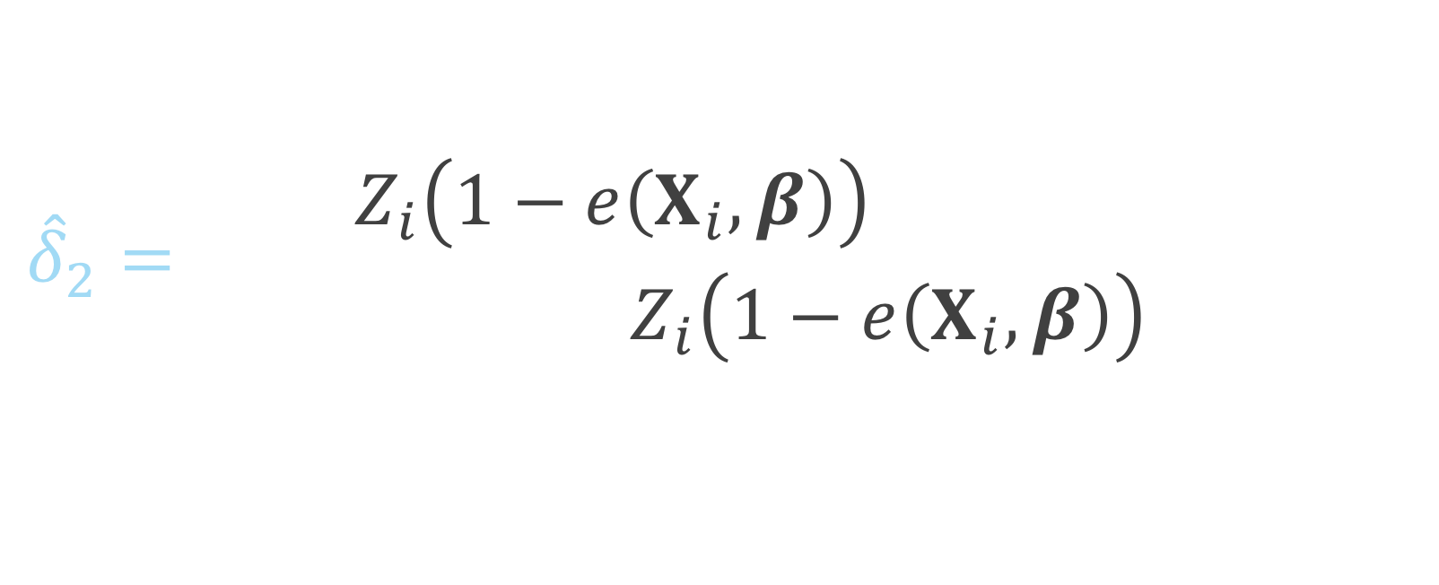
ATO DR estimator
$${\hat{Δ}}_{DR, ATO}={\hat{δ}}_{1}+{\hat{δ}}_{2}−{\hat{δ}}_{3}$$
$${\hat{δ}}_{2}=\frac{\sum_{i=1}^{n}{Z_{i}\left(1−e\left(X_{i},β\right)\right)\left(Y_{i}−m_{1}\left(X_{i},{\hat{α}}_{1}\right)\right)}}{\sum_{i=1}^{n}{Z_{i}\left(1−e\left(X_{i},β\right)\right)}}$$
Notes:
This piece is essentially the residual between the observed Y among the treated and the predicted Y among the treated

Slide 106
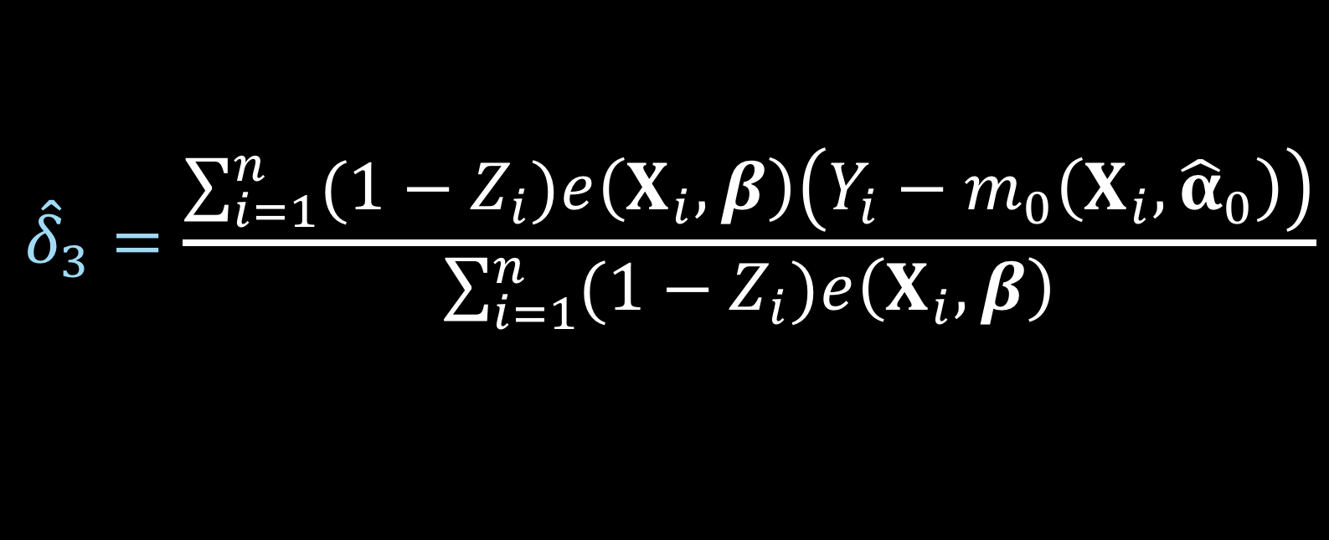
ATO DR estimator
$${\hat{Δ}}_{DR, ATO}={\hat{δ}}_{1}+{\hat{δ}}_{2}−{\hat{δ}}_{3}$$
$${\hat{δ}}_{3}=\frac{\sum_{i=1}^{n}{{(1−Z}_{i})e\left(X_{i},β\right)\left(Y_{i}−m_{0}\left(X_{i},{\hat{α}}_{0}\right)\right)}}{\sum_{i=1}^{n}{{(1−Z}_{i})e\left(X_{i},β\right)}}$$
Notes:
Here is delta 3

Slide 107
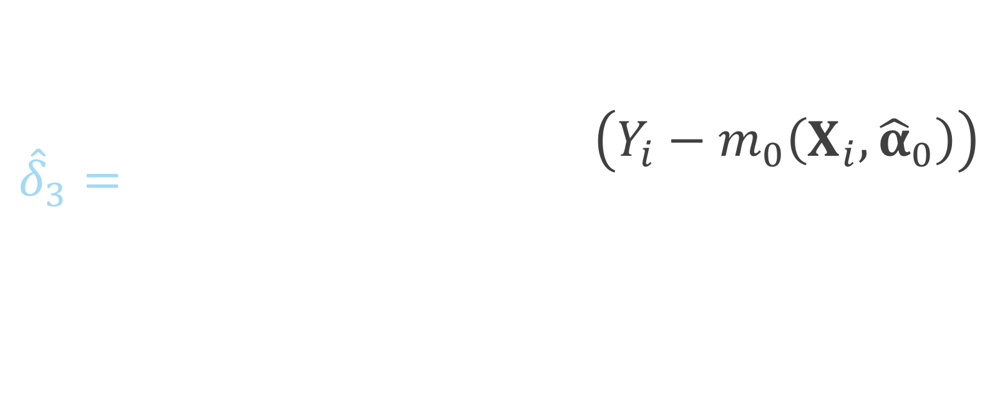
ATO DR estimator
$${\hat{Δ}}_{DR, ATO}={\hat{δ}}_{1}+{\hat{δ}}_{2}−{\hat{δ}}_{3}$$
$${\hat{δ}}_{3}=\frac{\sum_{i=1}^{n}{{(1−Z}_{i})e\left(X_{i},β\right)\left(Y_{i}−m_{0}\left(X_{i},{\hat{α}}_{0}\right)\right)}}{\sum_{i=1}^{n}{{(1−Z}_{i})e\left(X_{i},β\right)}}$$
Notes:
This summation is just among the controls, if the participant is in the treated group, 1 – Zi will be 0

Slide 108
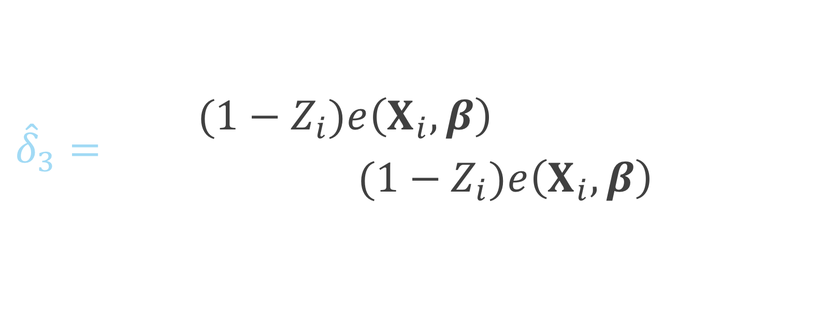
ATO DR estimator
$${\hat{Δ}}_{DR, ATO}={\hat{δ}}_{1}+{\hat{δ}}_{2}−{\hat{δ}}_{3}$$
$${\hat{δ}}_{3}=\frac{\sum_{i=1}^{n}{{(1−Z}_{i})e\left(X_{i},β\right)\left(Y_{i}−m_{0}\left(X_{i},{\hat{α}}_{0}\right)\right)}}{\sum_{i=1}^{n}{{(1−Z}_{i})e\left(X_{i},β\right)}}$$
Notes:
And this is the residual of the observed y among the controls and the predicted y, fit among the controls

Slide 109


ATO DR estimator
$$u\left(θ\right)=\left(\begin{matrix}(m_{1}\left(X, α_{1}\right)−m_{0}\left(X, α_{0}\right)−δ_{1})(Z\left(1−e\left(X,β\right)\right)+\left(1−Z\right)e\left(X,β\right)) \\ \left(Y−m_{1}\left(X, α_{1}\right)−δ_{2}\right)Z(1−e\left(X,β\right)) \\ \begin{aligned}\left(Y−m_{0}\left(X, α_{0}\right)−δ_{3}\right)\left(1−Z\right)e\left(X, β\right) \\ \left(Y−m_{1}\left(X,α_{0}\right)\right)ZX \\ \left(Y−m_{0}\left(X,α_{0}\right)\right)\left(1−Z\right)X \\ X\left(Z−e\left(X,β\right)\right)\end{aligned}\end{matrix}\right)$$
$$θ={\left(δ_{1}, δ_{2},δ_{3},α_{1}^{T},α_{0}^{T},β^{T}\right)}^{T}$$
Notes:
Again this can be solved by simultaneously solving these estimating equations. Note here that this technically will only be correct if both the outcome model AND the propensity score model are correctly specified.

Slide 110

ATO DR estimator
$$u\left(θ\right)=\left(\begin{matrix}(m_{1}\left(X, α_{1}\right)−m_{0}\left(X, α_{0}\right)−δ_{1})(Z\left(1−e\left(X,β\right)\right)+\left(1−Z\right)e\left(X,β\right)) \\ \left(Y−m_{1}\left(X, α_{1}\right)−δ_{2}\right)Z(1−e\left(X,β\right)) \\ \begin{aligned}\left(Y−m_{0}\left(X, α_{0}\right)−δ_{3}\right)\left(1−Z\right)e\left(X, β\right) \\ \left(Y−m_{1}\left(X,α_{0}\right)\right)ZX \\ \left(Y−m_{0}\left(X,α_{0}\right)\right)\left(1−Z\right)X \\ X\left(Z−e\left(X,β\right)\right)\end{aligned}\end{matrix}\right)$$
$$θ={\left(δ_{1}, δ_{2},δ_{3},α_{1}^{T},α_{0}^{T},β^{T}\right)}^{T}$$
Notes:
This is more complicated than the large-sample variance that we derived for the ATO IPW estimator because now we have more parameters to solve for, rather than just mu1, mu0 and beta, we now have delta 1 2 and 3, and alpha 1 and 0 from the outcome models

Slide 111

ATO DR estimator
$$u\left(θ\right)=\left(\begin{matrix}(m_{1}\left(X, α_{1}\right)−m_{0}\left(X, α_{0}\right)−δ_{1})(Z\left(1−e\left(X,β\right)\right)+\left(1−Z\right)e\left(X,β\right)) \\ \left(Y−m_{1}\left(X, α_{1}\right)−δ_{2}\right)Z(1−e\left(X,β\right)) \\ \begin{aligned}\left(Y−m_{0}\left(X, α_{0}\right)−δ_{3}\right)\left(1−Z\right)e\left(X, β\right) \\ \left(Y−m_{1}\left(X,α_{0}\right)\right)ZX \\ \left(Y−m_{0}\left(X,α_{0}\right)\right)\left(1−Z\right)X \\ X\left(Z−e\left(X,β\right)\right)\end{aligned}\end{matrix}\right)$$
$$θ={\left(δ_{1}, δ_{2},δ_{3},α_{1}^{T},α_{0}^{T},β^{T}\right)}^{T}$$
Notes:
These equations incorporate the weights, as seen here

Slide 112

ATO DR estimator
$$u\left(θ\right)=\left(\begin{matrix}(m_{1}\left(X, α_{1}\right)−m_{0}\left(X, α_{0}\right)−δ_{1})(Z\left(1−e\left(X,β\right)\right)+\left(1−Z\right)e\left(X,β\right)) \\ \left(Y−m_{1}\left(X, α_{1}\right)−δ_{2}\right)Z(1−e\left(X,β\right)) \\ \begin{aligned}\left(Y−m_{0}\left(X, α_{0}\right)−δ_{3}\right)\left(1−Z\right)e\left(X, β\right) \\ \left(Y−m_{1}\left(X,α_{0}\right)\right)ZX \\ \left(Y−m_{0}\left(X,α_{0}\right)\right)\left(1−Z\right)X \\ X\left(Z−e\left(X,β\right)\right)\end{aligned}\end{matrix}\right)$$
$$θ={\left(δ_{1}, δ_{2},δ_{3},α_{1}^{T},α_{0}^{T},β^{T}\right)}^{T}$$
Notes:
Notice here we are looking at the difference between the predicted Y among the treated and predicted Y among the controls minus delta1, which is the estimated difference between the two, so when we sum over all participants this will be zero

Slide 113

ATO DR estimator
$$u\left(θ\right)=\left(\begin{matrix}(m_{1}\left(X, α_{1}\right)−m_{0}\left(X, α_{0}\right)−δ_{1})(Z\left(1−e\left(X,β\right)\right)+\left(1−Z\right)e\left(X,β\right)) \\ \left(Y−m_{1}\left(X, α_{1}\right)−δ_{2}\right)Z(1−e\left(X,β\right)) \\ \begin{aligned}\left(Y−m_{0}\left(X, α_{0}\right)−δ_{3}\right)\left(1−Z\right)e\left(X, β\right) \\ \left(Y−m_{1}\left(X,α_{0}\right)\right)ZX \\ \left(Y−m_{0}\left(X,α_{0}\right)\right)\left(1−Z\right)X \\ X\left(Z−e\left(X,β\right)\right)\end{aligned}\end{matrix}\right)$$
$$θ={\left(δ_{1}, δ_{2},δ_{3},α_{1}^{T},α_{0}^{T},β^{T}\right)}^{T}$$
Notes:
Here we are taking the observed Y minus the predicted Y among the treated minus delta 2

Slide 114

ATO DR estimator
$$u\left(θ\right)=\left(\begin{matrix}(m_{1}\left(X, α_{1}\right)−m_{0}\left(X, α_{0}\right)−δ_{1})(Z\left(1−e\left(X,β\right)\right)+\left(1−Z\right)e\left(X,β\right)) \\ \left(Y−m_{1}\left(X, α_{1}\right)−δ_{2}\right)Z(1−e\left(X,β\right)) \\ \begin{aligned}\left(Y−m_{0}\left(X, α_{0}\right)−δ_{3}\right)\left(1−Z\right)e\left(X, β\right) \\ \left(Y−m_{1}\left(X,α_{0}\right)\right)ZX \\ \left(Y−m_{0}\left(X,α_{0}\right)\right)\left(1−Z\right)X \\ X\left(Z−e\left(X,β\right)\right)\end{aligned}\end{matrix}\right)$$
$$θ={\left(δ_{1}, δ_{2},δ_{3},α_{1}^{T},α_{0}^{T},β^{T}\right)}^{T}$$
Notes:
The observed Y among the controls minus the predicted minus delta 3

Slide 115

ATO DR estimator
$$u\left(θ\right)=\left(\begin{matrix}(m_{1}\left(X, α_{1}\right)−m_{0}\left(X, α_{0}\right)−δ_{1})(Z\left(1−e\left(X,β\right)\right)+\left(1−Z\right)e\left(X,β\right)) \\ \left(Y−m_{1}\left(X, α_{1}\right)−δ_{2}\right)Z(1−e\left(X,β\right)) \\ \begin{aligned}\left(Y−m_{0}\left(X, α_{0}\right)−δ_{3}\right)\left(1−Z\right)e\left(X, β\right) \\ \left(Y−m_{1}\left(X,α_{0}\right)\right)ZX \\ \left(Y−m_{0}\left(X,α_{0}\right)\right)\left(1−Z\right)X \\ X\left(Z−e\left(X,β\right)\right)\end{aligned}\end{matrix}\right)$$
$$θ={\left(δ_{1}, δ_{2},δ_{3},α_{1}^{T},α_{0}^{T},β^{T}\right)}^{T}$$
Notes:
The observed Y minus the predicted Y among the treated

Slide 116

ATO DR estimator
$$u\left(θ\right)=\left(\begin{matrix}(m_{1}\left(X, α_{1}\right)−m_{0}\left(X, α_{0}\right)−δ_{1})(Z\left(1−e\left(X,β\right)\right)+\left(1−Z\right)e\left(X,β\right)) \\ \left(Y−m_{1}\left(X, α_{1}\right)−δ_{2}\right)Z(1−e\left(X,β\right)) \\ \begin{aligned}\left(Y−m_{0}\left(X, α_{0}\right)−δ_{3}\right)\left(1−Z\right)e\left(X, β\right) \\ \left(Y−m_{1}\left(X,α_{0}\right)\right)ZX \\ \left(Y−m_{0}\left(X,α_{0}\right)\right)\left(1−Z\right)X \\ X\left(Z−e\left(X,β\right)\right)\end{aligned}\end{matrix}\right)$$
$$θ={\left(δ_{1}, δ_{2},δ_{3},α_{1}^{T},α_{0}^{T},β^{T}\right)}^{T}$$
Notes:
The observed Y minus the predicted among the controls

Slide 117

ATO DR estimator
$$u\left(θ\right)=\left(\begin{matrix}(m_{1}\left(X, α_{1}\right)−m_{0}\left(X, α_{0}\right)−δ_{1})(Z\left(1−e\left(X,β\right)\right)+\left(1−Z\right)e\left(X,β\right)) \\ \left(Y−m_{1}\left(X, α_{1}\right)−δ_{2}\right)Z(1−e\left(X,β\right)) \\ \begin{aligned}\left(Y−m_{0}\left(X, α_{0}\right)−δ_{3}\right)\left(1−Z\right)e\left(X, β\right) \\ \left(Y−m_{1}\left(X,α_{0}\right)\right)ZX \\ \left(Y−m_{0}\left(X,α_{0}\right)\right)\left(1−Z\right)X \\ X\left(Z−e\left(X,β\right)\right)\end{aligned}\end{matrix}\right)$$
$$θ={\left(δ_{1}, δ_{2},δ_{3},α_{1}^{T},α_{0}^{T},β^{T}\right)}^{T}$$
Notes:
Finally the estimating equation for the propensity score model

Slide 118
Sandwich estimator
$$var\left(θ\right)=A^{−1}BA^{−T}$$
Notes:
Again, we are using the sandwich estimator to approximate the large sample variance

Slide 119

ATO DR estimator
$${\hat{Δ}}_{DR, ATO}={\hat{δ}}_{1}+{\hat{δ}}_{2}−{\hat{δ}}_{3}$$
$$var\left({\hat{Δ}}_{DR, ATO}\right)=\left(1 1 −1 0 0 0\right){\frac{1}{n}\hat{A}}_{n}^{−1} {\hat{B}}_{n}{\hat{A}}_{n}^{−T}\left({1 \atop \begin{aligned}1 \\ −1 \\ 0 \\ 0 \\ 0\end{aligned}}\right)$$
Notes:
Because we are estimating delta 1 plus delta 2 minus delta 3, after we estimate our sandwich estimator

Slide 120

ATO DR estimator
$${\hat{Δ}}_{DR, ATO}={\hat{δ}}_{1}+{\hat{δ}}_{2}−{\hat{δ}}_{3}$$
$$\hat{var}\left({\hat{Δ}}_{DR, ATO}\right)=\left(1 1 −1 0 0 0\right){\frac{1}{n}\hat{A}}_{n}^{−1} {\hat{B}}_{n}{\hat{A}}_{n}^{−T}\left({1 \atop \begin{aligned}1 \\ −1 \\ 0 \\ 0 \\ 0\end{aligned}}\right)$$
Notes:
This will be our variance estimator where

Slide 121

ATO DR estimator
$${\hat{Δ}}_{DR, ATO}={\hat{δ}}_{1}+{\hat{δ}}_{2}−{\hat{δ}}_{3}$$
$$\hat{var}\left({\hat{Δ}}_{DR, ATO}\right)=\left(1 1 −1 0 0 0\right){\frac{1}{n}\hat{A}}_{n}^{−1} {\hat{B}}_{n}{\hat{A}}_{n}^{−T}\left({1 \atop \begin{aligned}1 \\ −1 \\ 0 \\ 0 \\ 0\end{aligned}}\right)$$
Notes:
We will multiply by the vector 1 1 -1 with the remaining entries 0 on both sides

Slide 122

ATO DR estimator
$${\hat{Δ}}_{DR, ATO}={\hat{δ}}_{1}+{\hat{δ}}_{2}−{\hat{δ}}_{3}$$
$$\hat{var}\left({\hat{Δ}}_{DR, ATO}\right)=\left(1 1 −1 0 0 0\right){\frac{1}{n}\hat{A}}_{n}^{−1} {\hat{B}}_{n}{\hat{A}}_{n}^{−T}\left({1 \atop \begin{aligned}1 \\ −1 \\ 0 \\ 0 \\ 0\end{aligned}}\right)$$
Notes:
Of our estimated sandwich variance to approximate the variance of this quantity

Slide 123
Freedman & Berk* Simulation

Slide 124
correct-correct correct-wrong wrong-correct wrong-wrong
Notes:
We have 4 settings, and in fact we actually have 6, because we observe 3 different settings in the wrong-wrong case

Slide 125
correct-correct correct-wrong wrong-correct wrong-wrong

Slide 126
correct-correct correct-wrong wrong-correct wrong-wrong

Slide 127
correct-correct correct-wrong wrong-correct wrong-wrong

Slide 128
correct-correct correct-wrong wrong-correct wrong-wrong
extreme
moderate
slight

Slide 129
bias ratio estimated se / true se RMSE 95% coverage

Slide 130
bias ratio estimated se / true se RMSE 95% coverage

Slide 131
Continuous outcome

Slide 132

Simulation
$$X \sim MVN\left(\left({0.5 \atop 1}\right), \left(\begin{matrix}2 & 1 \\ 1 & 1\end{matrix}\right)\right)$$
$$V \sim N \left(0, 1\right)$$
$$Z=\left\{\begin{aligned}1 0.5+0.25X_{1}+0.75X_{2}+V>0 \\ &0 o.w.\end{aligned}\right.$$
$$U \sim N(0, 1)$$
$$Y=1+Z+X_{1}+3X_{2}+U$$

Slide 133

Simulation
$$X \sim MVN\left(\left({0.5 \atop 1}\right), \left(\begin{matrix}2 & 1 \\ 1 & 1\end{matrix}\right)\right)$$
$$V \sim N \left(0, 1\right)$$
$$Z=\left\{\begin{aligned}1 0.5+0.25X_{1}+0.75X_{2}+V>0 \\ &0 o.w.\end{aligned}\right.$$
$$U \sim N(0, 1)$$
$$Y=1+Z+X_{1}+3X_{2}+U$$

Slide 134
correct-correct

Slide 135
correct-correct

Slide 136
correct-wrong

Slide 137
correct-wrong

Slide 138
wrong-correct

Slide 139
wrong-correct

Slide 140
wrong-wrong

Slide 141
wrong-wrong

Slide 142
wrong-wrong

Slide 143
wrong-wrong
Notes:
Even here, in a less extreme case (we’ve made the size of the unmeasured confounder pretty small) you still see by the time N = 5000, the bias fully takes over the variance, pulling the coverage to 0.

Slide 144
Recap
Derived the DR estimator and large sample variance for ATO
Compared to conventional methods
When the outcome model is correctly specified, robust standard errors obtained from a generalized linear model perform well, otherwise our large-sample variance is preferred
If a confounder is completely left out, we need alternative methods to adjust for the bias

Slide 145
Q&A

Slide 146
Contextualized Tipping Point Sensitivity Analyses for Unmeasured Confounding

Slide 147
Motivation
Review of 90 observational studies JAMA, the NEJM, and the AJE
41 mentioned the issue of unmeasured confounding as a limitation
4 performed a quantitative sensitivity analysis
Notes:
We conducted a review of 90 observational studies with statistically significant findings published in 2015 in the Journal of the American Medical Association, the New England Journal of Medicine, and the American Journal of Epidemiology. 41 (45.6%) mentioning the issue of unmeasured confounding as a limitation and only 4 (4.4%) performing a quantitative sensitivity analysis.

Slide 148
What we want
Simplified
Contextualized
Transparent
Notes:
Contextualized, we want it to be grounded in the analysis that was conducted

Slide 149
What we want
Simplified
Contextualized
Transparent
Notes:
We want a sensitivity analysis that is simplified, ideally can be summarized in a single line in a manuscript
Contextualized, we want it to be grounded in the analysis that was conducted

Slide 150
What we want
Simplified
Contextualized
Transparent
Notes:
I want you to provide details in your manuscript such that I could conduct my own sensitivity analysis if I think the pieces you included are insufficient

Slide 151

Binary unmeasured confounder
$$RR_{adj}=RR_{obs}\frac{RR_{UD}p_{0}+(1−p_{0})}{RR_{UD}p_{1}+(1−p_{1})}$$
Notes:
So here is the main equation that we use for binary unmeasured confounders. Basically we’re adjusting our observed exposure-outcome effect using quantities representing an unmeasured confounder to get an exposure-outcome effect that adjusts for the unmeasured confounder

Slide 152

Binary unmeasured confounder
$$RR_{adj}=RR_{obs}\frac{RR_{UD}p_{0}+(1−p_{0})}{RR_{UD}p_{1}+(1−p_{1})}$$
Notes:
Here RR obs is the effect between the treatment and outcome that you have observed, I denote this as RR, but Lin et al show that this could be an odds ratio or a hazard ratio in most settings

Slide 153

Binary unmeasured confounder
$$RR_{adj}=RR_{obs}\frac{RR_{UD}p_{0}+(1−p_{0})}{RR_{UD}p_{1}+(1−p_{1})}$$
Notes:
RR UD is the relative risk of the unmeasured confounder and the outcome – again this can be replaced with an odds ratio or hazard ratio

Slide 154

Binary unmeasured confounder
$$RR_{adj}=RR_{obs}\frac{RR_{UD}p_{0}+(1−p_{0})}{RR_{UD}p_{1}+(1−p_{1})}$$
Notes:
P0 and p1 are the prevalence of the unmeasured confounder in the unexposed and exposed populations

Slide 155

Binary unmeasured confounder
$$LB_{adj}=LB_{obs}\frac{RR_{UD}p_{0}+(1−p_{0})}{RR_{UD}p_{1}+(1−p_{1})}$$
Notes:
We can replace the exposure – outcome point estimate with the limiting bound of the exposure outcome effect (meaning the effect closest to the null)

Slide 156

Tipping point analyses
what will tip our confidence bound to cross 1

Slide 157

Binary unmeasured confounder
$$1=LB_{obs}\frac{RR_{UD}p_{0}+(1−p_{0})}{RR_{UD}p_{1}+(1−p_{1})}$$
Notes:
To create a tipping point, we can set the adjusted effect to 1 (the null), and solve for RRUD, p0 or p1

Slide 158

Binary unmeasured confounder
$$RR_{UD}\left(LB_{obs}, p_{0}, p_{1}\right)=\frac{\left(1−p_{1}\right)+LB_{obs}(p_{0}−1)}{LB_{obs}p_{0}−p_{1}}$$
Notes:
For example here we’ve solved for RR_UD – so if you provide the prevalences of an unmeasured confounder, you can solve for the association between the unmeasured confounder and outcome needed to tip your observed effect to inconclusive

Slide 159

Continuous unmeasured confounder
$$LB_{adj}=\frac{LB_{obs}}{RR_{UD}^{μ_{1}−μ_{0}}}$$
Notes:
We can also have a continuous unmeasured confounder, where it is assumed to be normally distributed with a mean mu and variance 1. The variance is assumed to be 1. Any normally distributed confounder can fit this specification by scaling by the standard deviation within each exposure group.

Slide 160

Continuous unmeasured confounder
$$LB_{adj}=\frac{LB_{obs}}{RR_{UD}^{μ_{1}−μ_{0}}}$$
Notes:
Mu1 is the mean of the unmeasured confounder in the exposed population and mu 0 is the mean of the unmeasured confounder in the unexposed population

Slide 161

Continuous unmeasured confounder
$$LB_{adj}=\frac{LB_{obs}}{RR_{UD}^{δ}}$$
Notes:
For simplicity, we can replace this difference with delta

Slide 162

Continuous unmeasured confounder
$$δ\left(LB_{obs}, RR_{UD}\right)=\frac{\log\left(LB_{obs}\right)}{\log\left(RR_{UD}\right)}$$
Notes:
We can again set the adjusted limiting bound to 1 and solve for any of the quantities, for example here we’ve solved for delta

Slide 163

Continuous unmeasured confounder
$$n\left(LB_{obs}, RR_{UD}, δ\right)=\frac{\log\left(LB_{obs}\right)}{δ\log\left(RR_{UD}\right)}$$
Notes:
Or we can even solve for n, how many unmeasured confounders of a certain size and mean difference would be needed to tip your analysis

Slide 164

“Assumption free”
$$1=LB_{obs}\frac{RR_{UD}/RR_{EU}+\left(1−1/RR_{EU}\right)}{RR_{UD}}$$
Notes:
Ding and Vanderweele build on this same methodology to create what they call an “assumption free” analysis, so you don’t have to assume

Slide 165


“Assumption free”
$$1=LB_{obs}\frac{RR_{UD}/RR_{EU}+\left(1−1/RR_{EU}\right)}{RR_{UD}}$$
$$RR_{EU}=\frac{p_{1}}{p_{0}}$$
Notes:
Here RR_EU is the relationship between the unmeasured confounder and the exposure, the way they are able to summarize this in a single number for the binary case, rather than with p1 and p0 is they set p1 to 1

Slide 166

“Assumption free”
$$1=LB_{obs}\frac{RR_{UD}/RR_{EU}+\left(1−1/RR_{EU}\right)}{RR_{UD}}$$
$$RR_{EU}=\frac{1}{p_{0}}$$

Slide 167
E-value
$$E−value=LB_{obs}+\sqrt{LB_{obs}×(LB_{obs}−1)}$$
Notes:
Vanderweele and Ding also rearrange their equation to be what they call an E-value, the point that minimizes the strength of association, on the risk ratio scale, that an unmeasured confounder would need to have with both the exposure and outcome, conditional on the measured covariates, to explain away an observed exposure-outcome association. This offers a great solution if you don’t have any idea for what kind of unmeasured confounder may be out there, but it has the disadvantage of being a bit hard to interpret in the context of your measured covariates

Slide 168

Adjusted E-value
$$E−{value}_{adj}=\frac{LB_{obs}}{LB_{adj}}+\sqrt{\frac{LB_{obs}}{LB_{adj}}×\left(\frac{LB_{obs}}{LB_{adj}}−1\right)}$$
Notes:
For this reason, we’ve used similar methodology to create an adjusted e-value, where we allow you to input the value you are trying to adjust to, rather than always setting the adjusted limiting bound to one. I will demonstrate soon how we can use this with our observed covariates

Slide 169
Meaningful confounders
1. How imbalanced is the confounder between the exposure groups?
2. How predictive is the confounder of the outcome?

Slide 170

Standardized mean difference
$$d=\frac{{\overline{x}}_{exposed}−{\overline{x}}_{unexposed}}{\sqrt{\frac{s_{exposed}^{2}+s_{unexposed}^{2}}{2}}}$$

Slide 171
Imbalance between exposures
Love Plots

Slide 172
Standardized Mean Difference
library(tidyr)
plot_df <- data.frame(
var = names(ExtractSmd(smd_table)),
Unadjusted = ExtractSmd(smd_table_unweighted ),
Weighted = ExtractSmd(smd_table)) %>%
gather("Method", "SMD", -var)

Slide 173
Standardized Mean Difference
library(ggplot2)
ggplot(
data = plot_df,
mapping = aes(x = var, y = SMD, group = Method, color = Method)
) +
geom_line() +
geom_point() +
geom_hline(yintercept = 0.1, color = "black", size = 0.1) +
coord_flip()

Slide 174
Love Plots

Slide 175
Outcome model
svyglm(
outcome ~ exposure,
data = svy_des,
family = binomial)

Slide 176
Outcome model
svyglm(
outcome ~ exposure,
data = svy_des,
family = binomial) %>%
confint(parm = “exposure”)

Slide 177
Outcome model
svyglm(
outcome ~ exposure,
data = svy_des,
family = binomial) %>%
confint(parm = “exposure”) %>%
exp()
#> 2.5% 97.5%
#> exposure 1.51 2.01

Slide 178
unmeasured confounding

Slide 179
All you need
Exposure-outcome effect
Exposure-unmeasured confounder effect
Outcome-unmeasured confounder effect

Slide 180
All you need
Exposure-outcome effect generally estimated from a model, for example an odds ratio, hazard ratio, or risk ratio
Exposure-unmeasured confounder effect
Outcome-unmeasured confounder effect
Odds Ratio Confidence Interval: (1.5, 2)

Slide 181
All you need
Exposure-outcome effect generally estimated from a model, for example an odds ratio, hazard ratio, or risk ratio
Exposure-unmeasured confounder effect
Outcome-unmeasured confounder effect

Slide 182
All you need
Exposure-outcome effect generally estimated from a model, for example an odds ratio, hazard ratio, or risk ratio
Exposure-unmeasured confounder effect can use my observed variables to estimate this
Outcome-unmeasured confounder effect

Slide 183
All you need
Exposure-outcome effect generally estimated from a model, for example an odds ratio, hazard ratio, or risk ratio
Exposure-unmeasured confounder effect can use my observed variables to estimate this
Outcome-unmeasured confounder effect

Slide 184
Exposure-unmeasured confounder effect
Prevalence of the unmeasured confounder among the exposed
Prevalence of the unmeasured confounder among the unexposed

Slide 185


$p_{0}=0.1$
$$p_{1}=0.3$$
Love Plots

Slide 186
Confounding
Confounder
$p_{0}=0.1$
?
$$p_{1}=0.3$$
Exposure
Outcome
Odds Ratio Confidence Interval: (1.5, 2)

Slide 187
Standardized Mean Difference
library(tipr)
tip_with_binary(
p0 = 0.1,
p1 = 0.3,
lb = 1.5,
ub = 2)

Slide 188
Standardized Mean Difference
library(tipr)
tip_with_binary(
p0 = 0.1,
p1 = 0.3,
lb = 1.5,
ub = 2)
#> [1] 4.333333

